Slide 1
Gamma-ray Sky from Fermi: Neutron Stars and their Environment
June 21-25, 2010, Hong Kong
Modeling GRB Afterglows
Numerically
Kong Siwei
Department of Astronomy, Nanjing University, China
Collaborators: Wong A. Y. L. (HKU), Huang, Y. F. (NJU), Cheng, K. S. (HKU),
Lu T. (PMO), Xu M. (NJU), Wang X. (NJU), Deng W. (NJU).

Slide 2
Outline
★ The discovery of GRB afterglow
★ The standard fireball model
★ Some modifications to the standard model

Slide 3
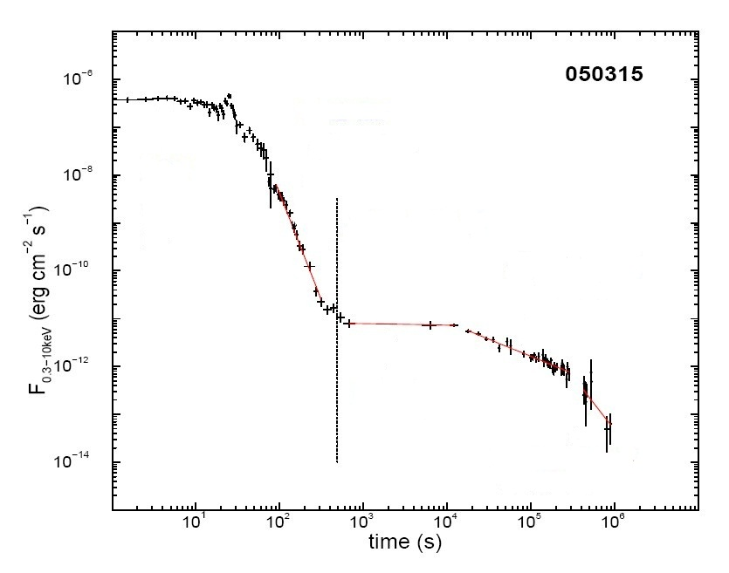
Afterglows are the counterparts of GRBs at lower frequencies.
Prompt emission
Aftergow phase
(Panaitescu 2008)

Slide 4
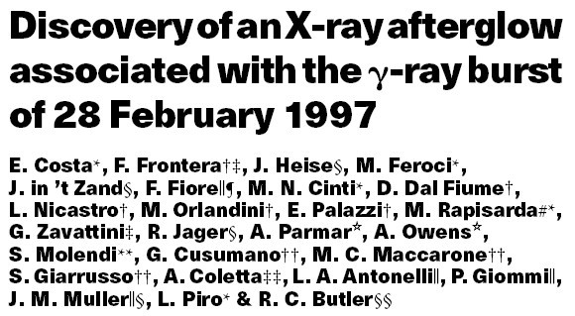
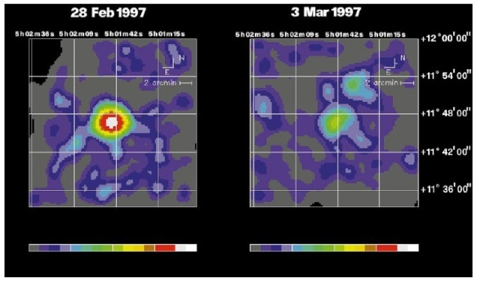
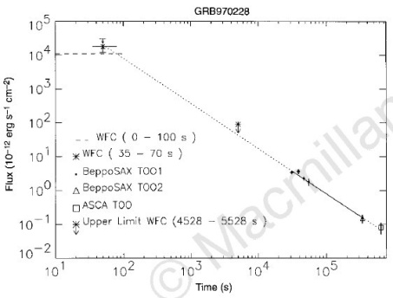
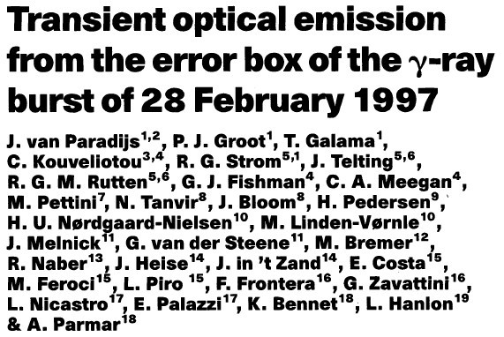
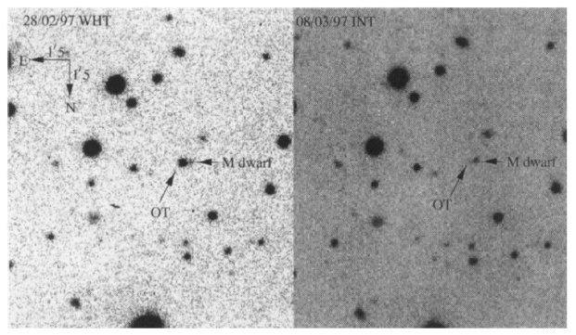
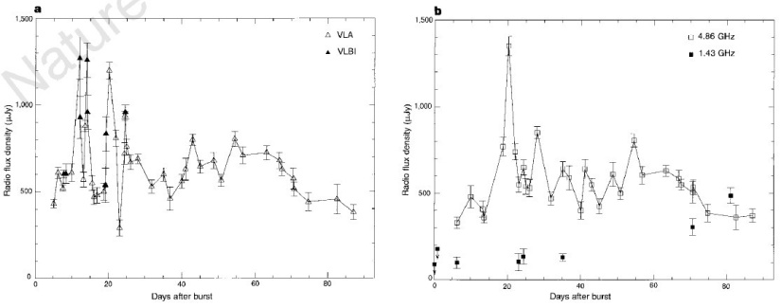
Discovery of GRB Afterglows
GRB 970228
GRB 970228
GRB 970508

Slide 5
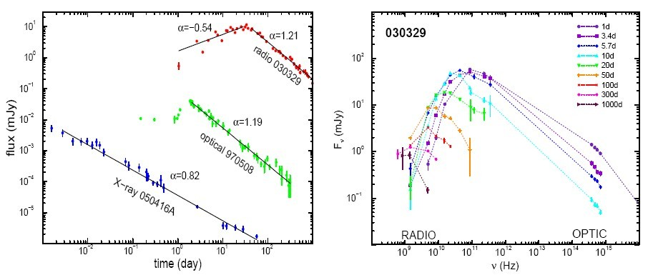
Light Curves and Spectrums - Power-law
(Panaitescu 2008)

Slide 6
Evolution and Radiation of External Shock
After a coasting phase, the external shock will enter the self-similar deceleration phase, and the bulk Lorentz factor of the shock will decrease as power-law of time (Blandford & McKee 1976).
The external shock will accelerate the electrons to the relativistic velocities and transfer some energy to the magnetic field.
These shock accelerated electrons is power-law distributed. They move in the magnetic field and produce the power-law synchrotron radiation spectrums and light curves.
Power-law
electron
Power-law
spectrum
Power-law
light curve
Power-law
dynamics

Slide 7
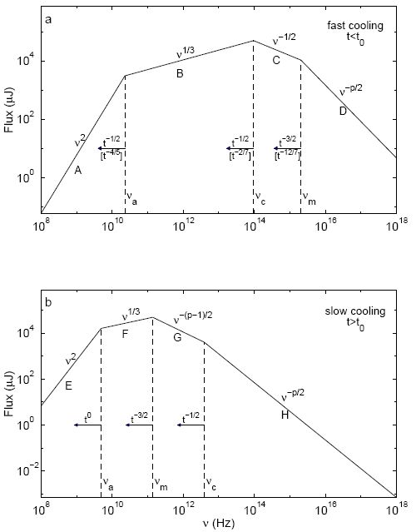
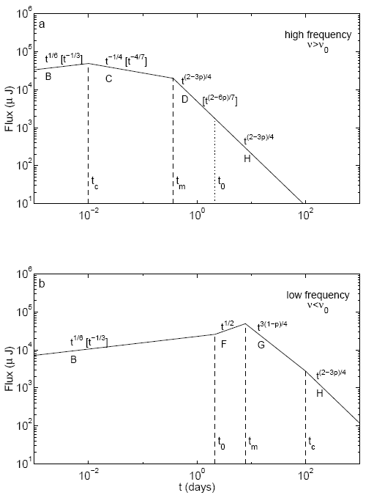
Spectrum
Light Curve
(Sari, Piran & Narayan 1998)

Slide 8
Dynamics of the Afterglow Evolution
(Huang et al. 1999, 2000)

Slide 9
The Synchrotron Radiation

Slide 10
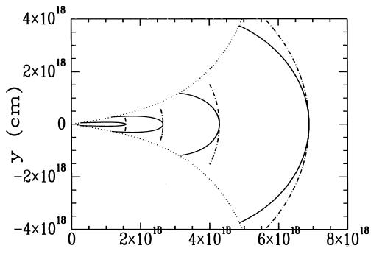
Equal Arrival Time Surface Effect
(Huang et al. 2000, 2007)

Slide 11
Purpose of the Modeling
Deduce the basic parameters of the GRB physics:
E_{iso} --- Isotropic energy in the jet
θ₀ --- Half opening angle of the jet
n --- Environmental density
ε_{e} --- Electron energy fraction
ε_{B} --- Magnetic field energy fraction
p --- Power-law index for the electron energy spectrum
These parameters are useful in studying the central engines and environments of GRBs, and also useful in the research of shock physics.

Slide 12
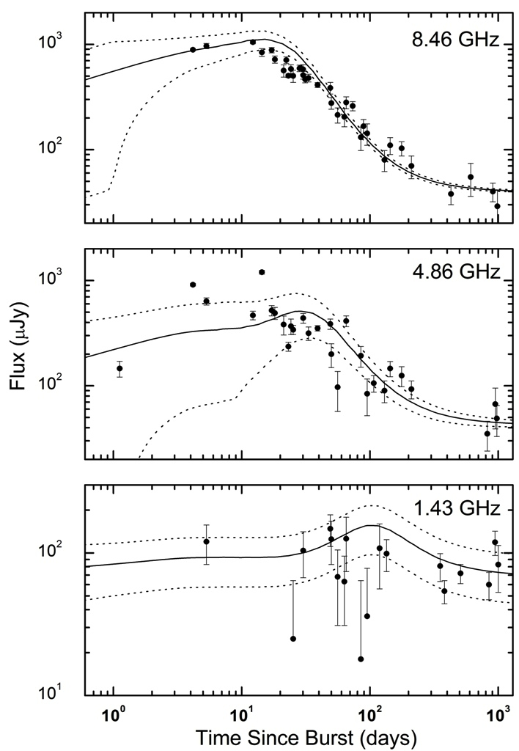
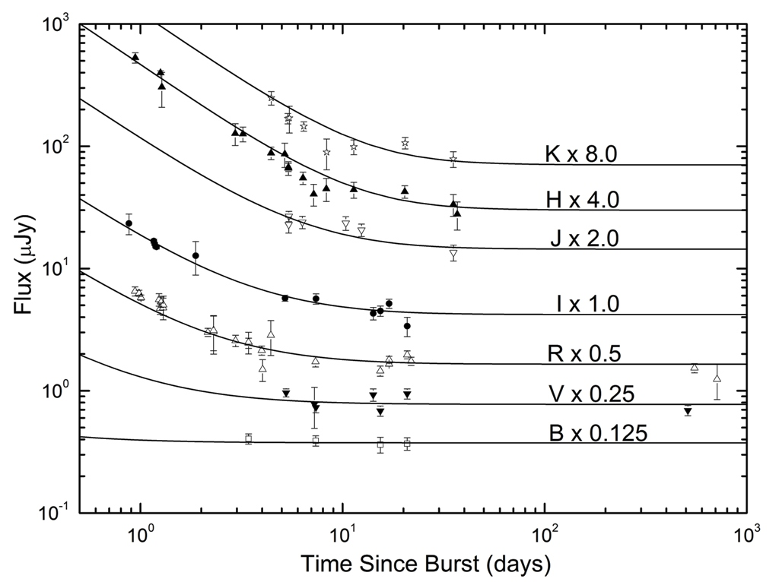
Modeling GRB 980703
KSW, Huang, Cheng, & Lu, 2009, Sci. China-Phys. Mech. Astron, 52, 2047

Slide 13
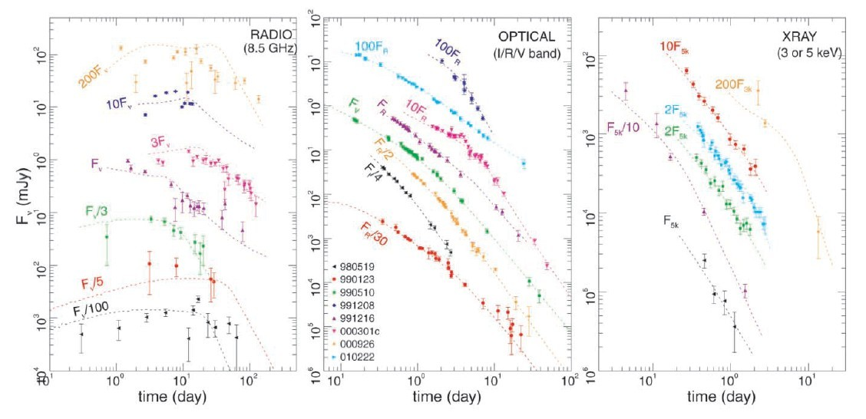
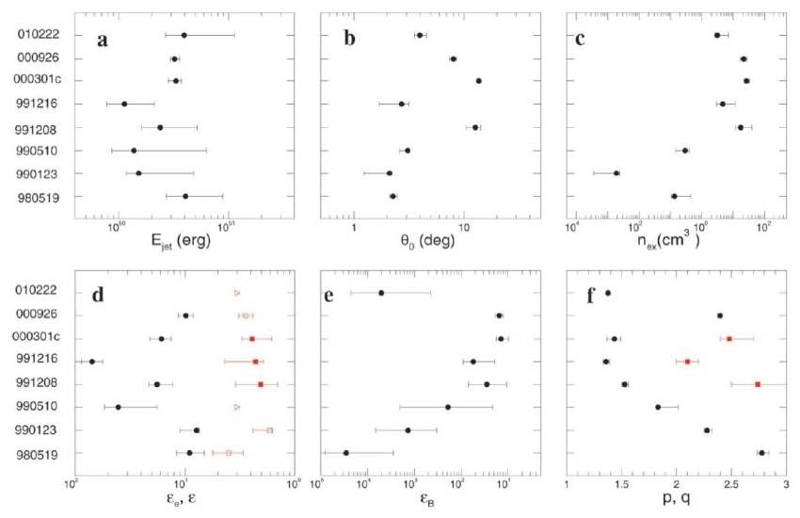
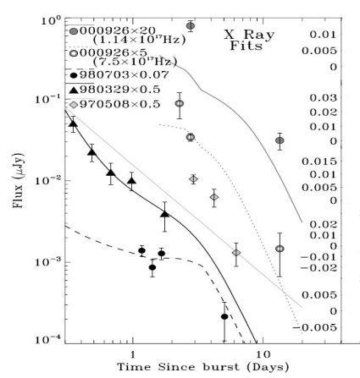
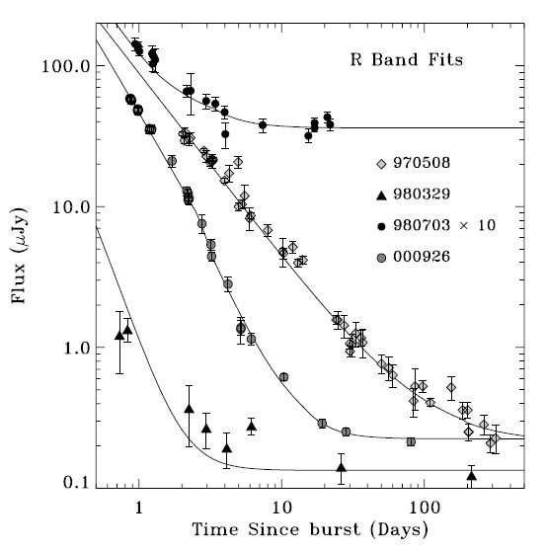
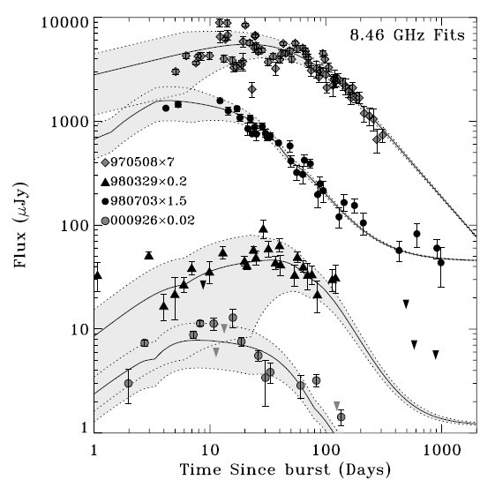
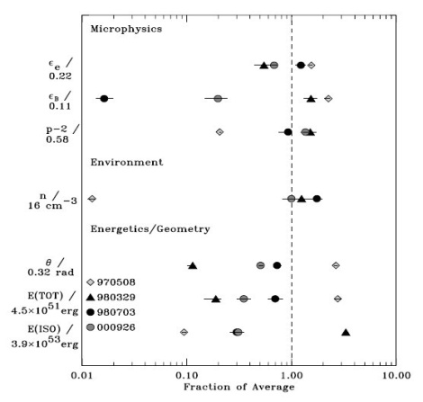
Some high-energy afterglows detected by LAT may also be produced by the external shock!
(Panaitescu & Kumar, 2001)
(Yost et al., 2003)

Slide 14
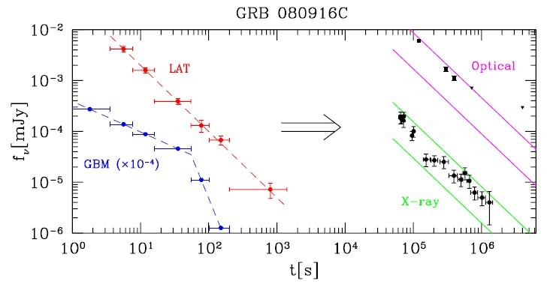
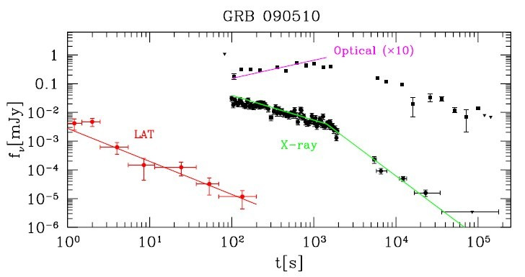
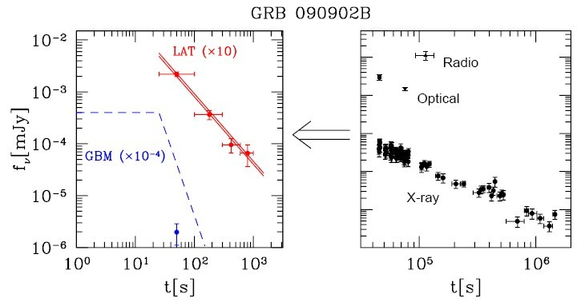
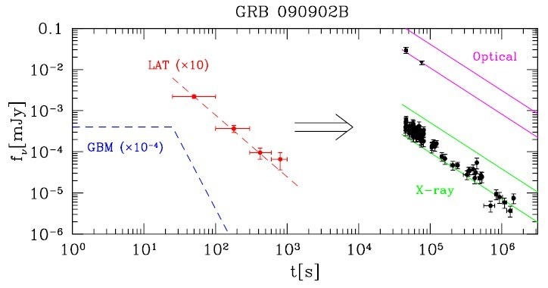
Adiabatic External Shock
(Kumar & Barniol Duran, 2009)

Slide 15
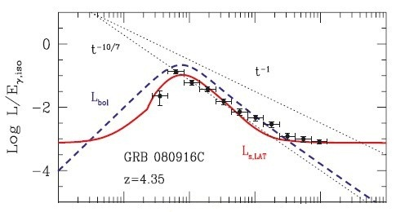
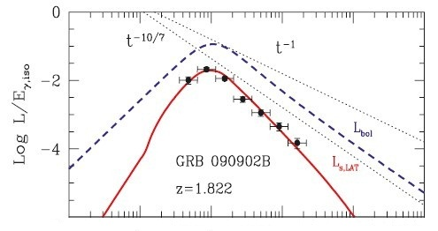
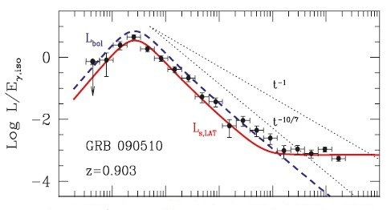
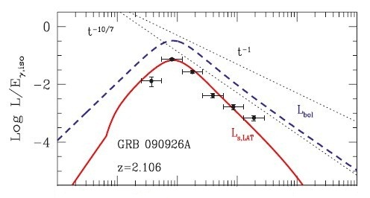
Radiative External Shock
(Ghisellini et al., 2010)

Slide 16
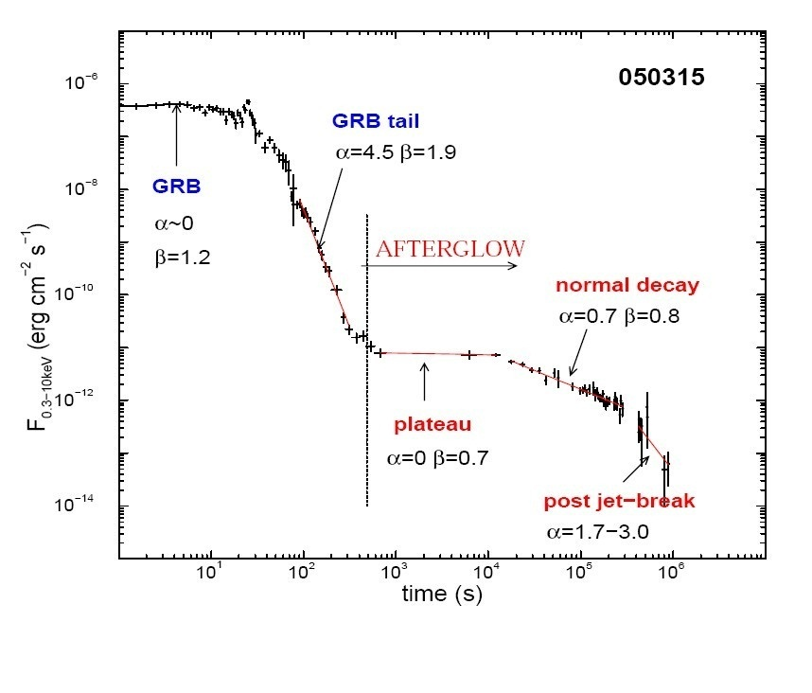
The standard fireball model can explain the general features of GRB afterglows. BUT there are also some strange features beyond the expectation of the standard model.
(1) Steep-shallow-normal decay phase in X-ray afterglow;
(Panaitescu 2008)

Slide 17
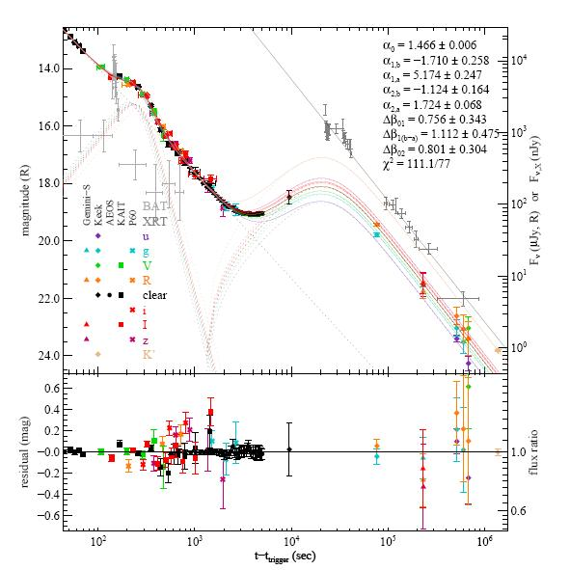
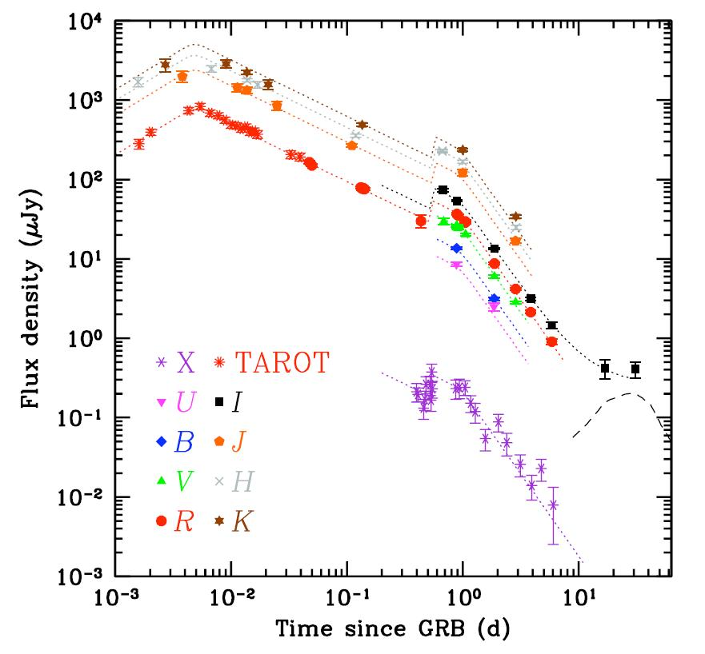
The standard fireball model can explain the general features of GRB afterglows. BUT there are also some strange features beyond the expectation of the standard model.
(1) Steep-shallow-normal decay phase in X-ray afterglow;
(2) Various rebrightenings;
GRB 071010A
GRB 071003
(Perley et al., 2008)
(Covino et al., 2008)

Slide 18
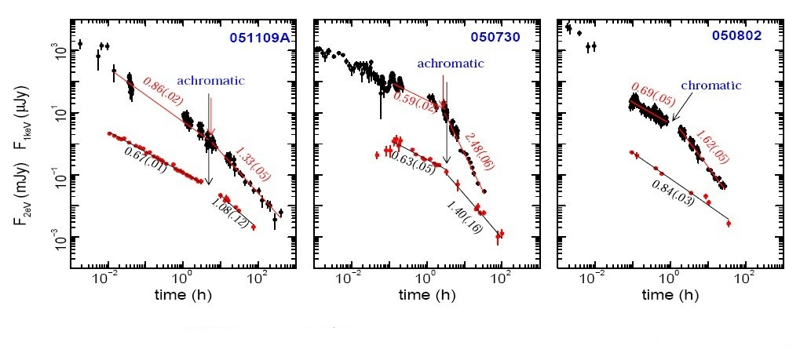
The standard fireball model can explain the general features of GRB afterglows. BUT there are also some strange features beyond the expectation of the standard model.
(1) Steep-shallow-normal decay phase in X-ray afterglow;
(2) Various rebrightenings;
(3) Achromatic and chromatic breaks;
(Panaitescu 2008)

Slide 19
We need to modify the standard model.
The standard fireball model can explain the general features of GRB afterglows. BUT there are also some strange features beyond the expectation of the standard model.
(1) Steep-shallow-normal decay phase in X-ray afterglow;
(2) Various rebrightenings;
(3) Achromatic and chromatic breaks;
……

Slide 20
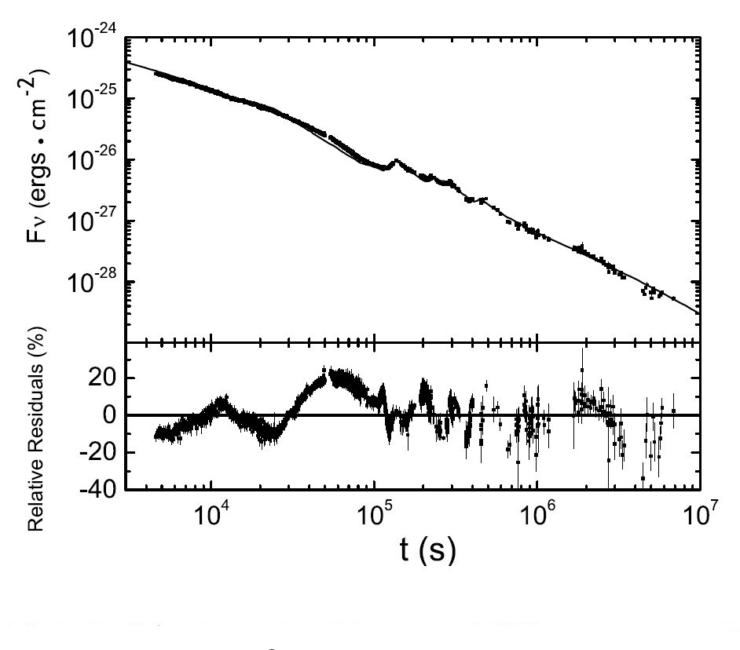
Modify the energy
(1) Energy in the jet is constant (Standard model);
(2) Sudden energy injection to the forward shock (Huang, Cheng & Gao 2006, Deng, Huang & KSW, 2010);
(Deng, Huang & KSW, 2010)

Slide 21
Modify the energy
(1) Energy in the jet is constant (Standard model);
(2) Sudden energy injection to the forward shock (Huang, Cheng & Gao 2006, Deng, Huang & KSW, 2010);
(3) Energy injection from a long-lasting central energy (Dai & Lu 1998, Zhang & Mészáros 2001, Zhang et al. 2006);
(4) Energy injection due to the different velocities of the ejecta (Rees & Mészáros 1998, Granot & Kumar 2006, Sari & Mészáros, 2000);
(5) Delayed energy transfer to the forward shock (Kobayashi & Zhang, 2007, Zhang 2007).

Slide 22
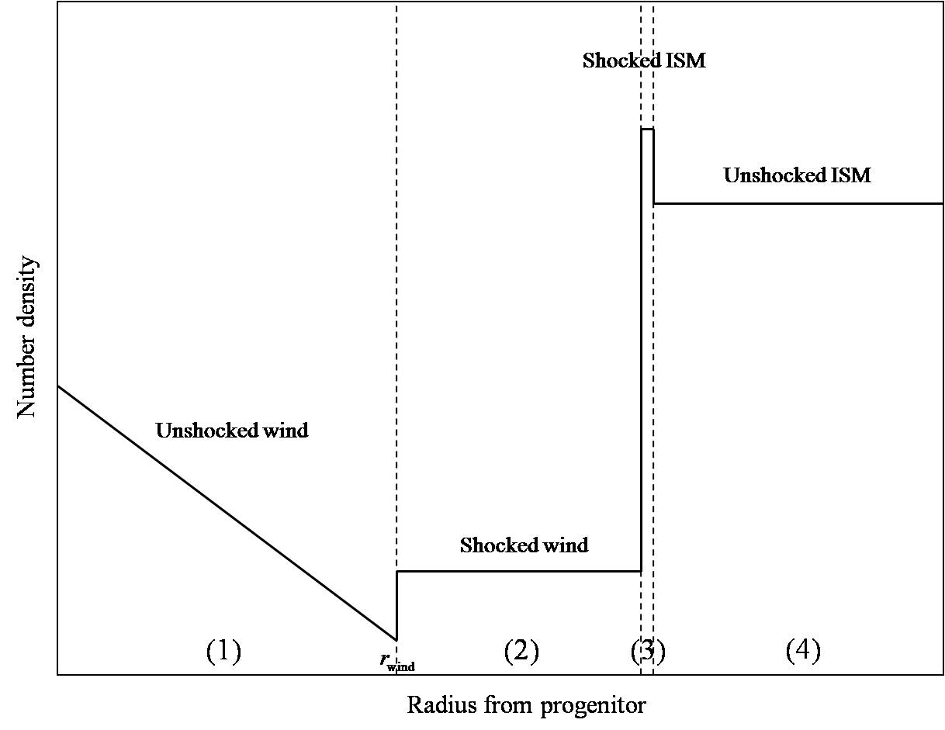
Modify the environment
(1) Interstellar medium (Standard model);
(2) Stellar wind (Dai & Lu 1998, Chevalier & Li 2000, Gou et al. 2001);
(3) Density enhancement (Dai & Lu 2002, Lazzati et al. 2002, Dai & Wu 2003, Tam et al. 2005);
(4) Termination shock (Ramirez-Ruiz et al. 2005; Pe’er & Wijers 2006, KSW, Wong, Huang, & Cheng, 2010).
(KSW, Wong, Huang & Cheng, 2010)

Slide 23
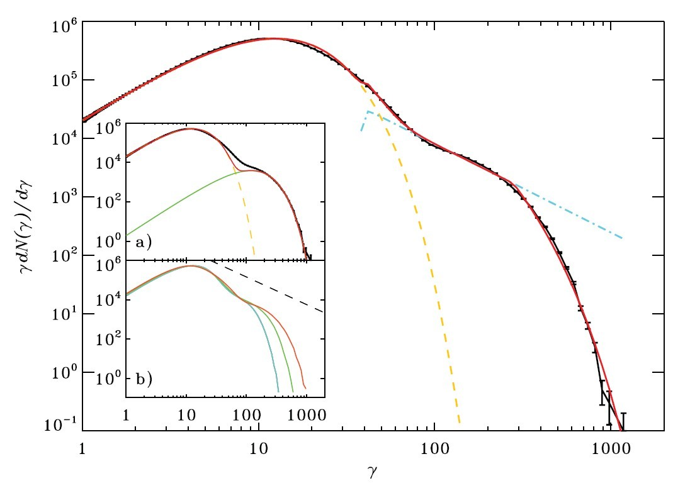
Modify the microphysics
(1) ε_{e}, ε_{B} and p are constant and electrons are power-law distributed (Standard model);
(2) Evolution of ε_{e}, ε_{B} and p (Ioka et al 2006, Fan & Piran 2006, Granot et al. 2006, Panaitescu 2006);
(3) Maxwellian component in the electron distribution (Spitkovsky 2008, Martins et al. 2008, Giannios & Spitkovsky, 2009).
Result from a particle-in-cell (PIC) simulation (Spitkovsky 2008)

Slide 24
Modify the features of the jet
(1) Homogeneous conical jet (Standard model);
(2) Jet with Gaussian angular profile (Zhang & Mészáros 2002, Kumar & Granot 2003);
(3) Two component jet (Huang et al. 2004, 2006, Liu et al. 2008);
(4) Cylindrical jet (Cheng et al. 2001, Huang & Cheng 2003, Tam et al. 2005);
(5) Ring-shaped jet (Eichler & Levinson 2004, Levinson & Eichler 2004, Lazzati & Begelman 2005, Xu, Huang & KSW, 2007, Xu & Huang 2010, Xu Ming’s Talk);
(6) Receding jet (Li & Song 2004, Wang, Huang & KSW 2009, Wang Xin’s talk);
(7) Off-axis jet (Panaitescu & Mészáros 1999, Eichler & Granot 2006).

Slide 25
Modify the radiative mechanism
(1) Synchrotron (Standard model);
(2) Synchrotron self-Compton (Sari & Esin 2001);
(3) Inverse Compton of external radiation field (He et al. 2009, Toma et al. 2009, 2010).
(4) Hadronic (Asano et al. 2009, Razzaque et al. 2009);
(5) Synchro-curvature (Cheng & Zhang 1996);
(6) Synchro-curvature self-Compton (Zhang Bo’s talk);
(7) Dust scattering (Shao & Dai 2006, 2007).

Slide 26
Termination Shock as the Environment
The medium surrounding GRBs is broken into four regions, from inside to out (Castor et al. 1975; Weaver 1977):
(1) the unshocked stellar wind;
(2) the shocked stellar wind;
(3) the shocked ISM;
(4) the unshocked ISM.
We only use Region (1) and Region (2) as the environment in our work, because the ejecta can not reach Region (3) during all the observable time (Pe’er & Wijers 2006).
KSW, Wong, Huang, & Cheng, 2010, Mon Not Roy Astron Soc, 402, 409

Slide 27
Variation of the Microphysics Parameters
The microphysics parameters may vary during the evolution of the fireball (Fan & Piran 2006). We can also imagine that the physical condition, such as the strength of the magnetic field, the temperature and density of the material, could be different between these two regions, so the evolution of microphysics parameters may not be the same accordingly. We use different parameters for these two regions to distinguish them and assume that
&
in Region (1)
in Region (2)
KSW, Wong, Huang, & Cheng, 2010, Mon Not Roy Astron Soc, 402, 409

Slide 28
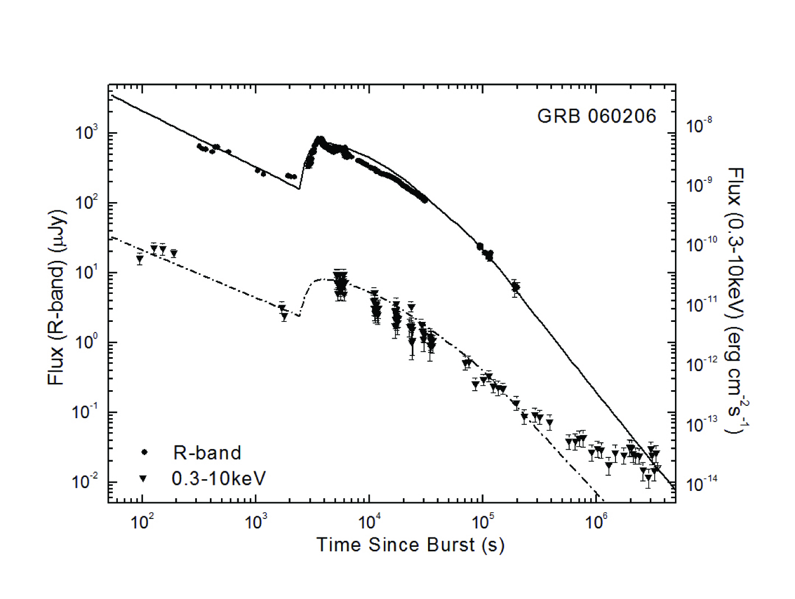
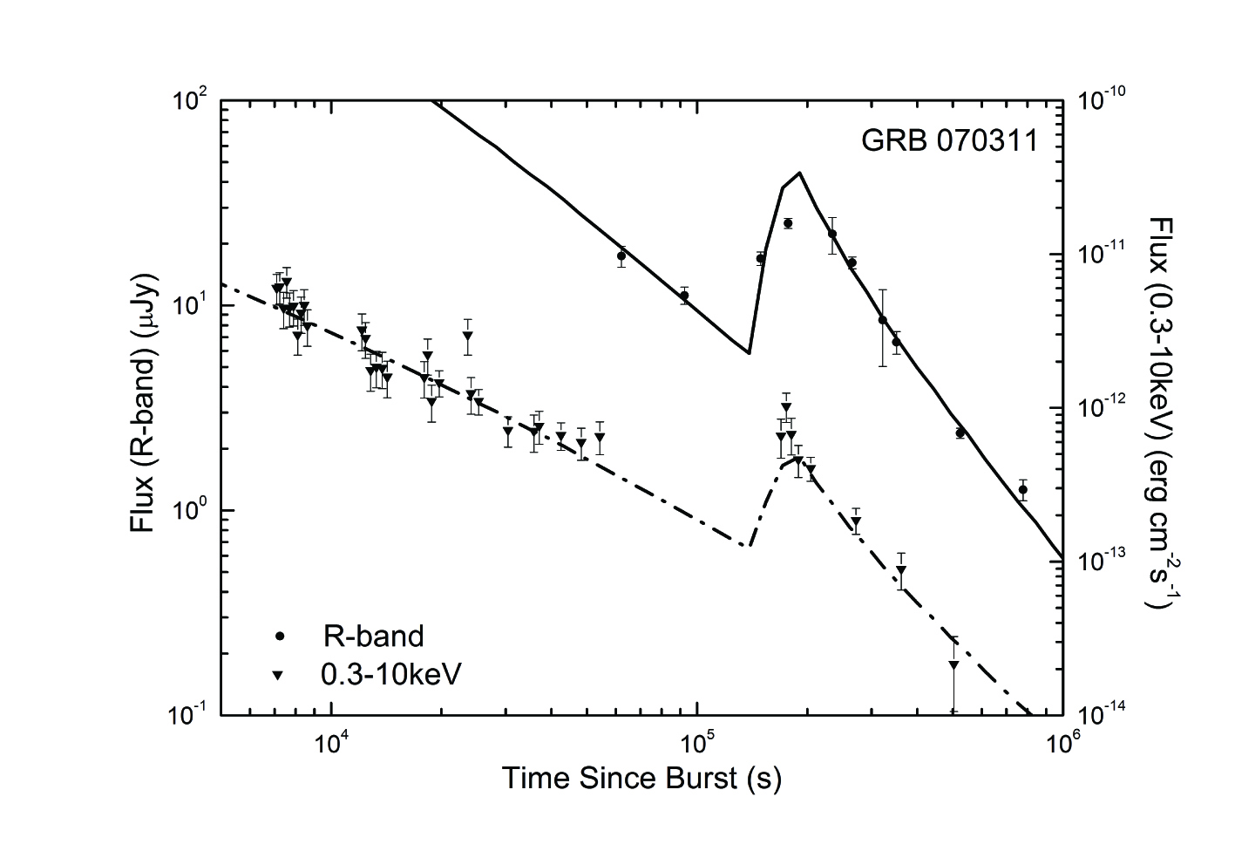
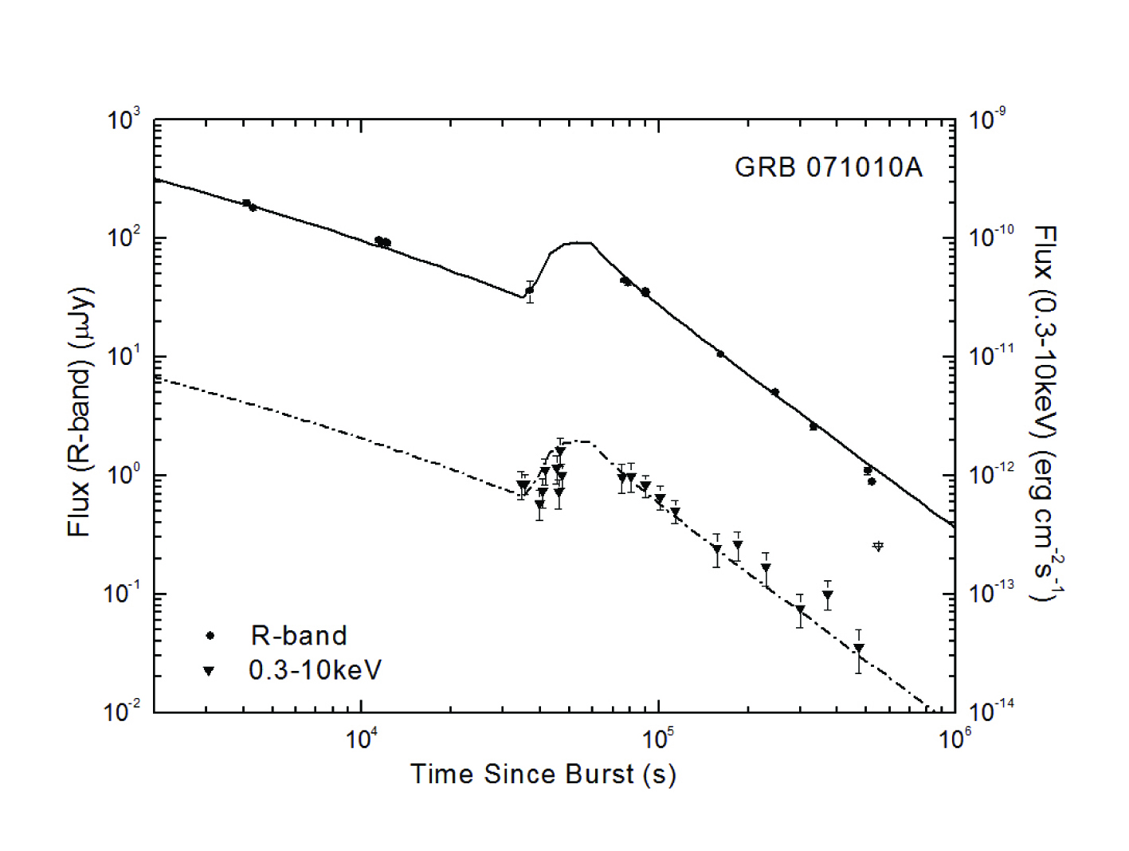
Comparison with Observations
KSW, Wong, Huang, & Cheng, 2010, Mon Not Roy Astron Soc, 402, 409

Slide 29
Summary
The standard fireball model can explain the general features of GRB afterglows.
At some times, we need to modify the standard model to explain some strange features in GRB afterglows.
We can use the un-modified or the modified standard model to reproduce the observed afterglow light curves of GRBs. Through the modeling, we can deduce the fundamental parameters, and further constrain the GRB physics and the shock physics.
Thank you!

