Slide 1
Neutron Star Environment: from Supernova Remnants to Pulsar Wind Nebulae
Stephen C.-Y. Ng
McGill University
Special thanks to Pat Slane for
some materials in this talk

Slide 2
Outline
SNRs and PWNe are important Galactic Gamma-ray sources
High energy emission of SNRs
Cosmic ray acceleration
Gamma-ray production
Overview of PWNe
PWNe in Gamma-rays

Slide 3
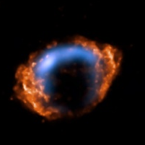
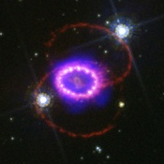
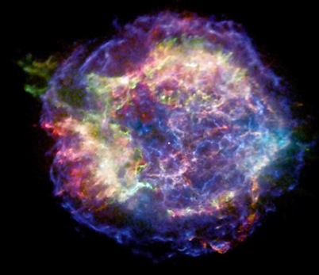
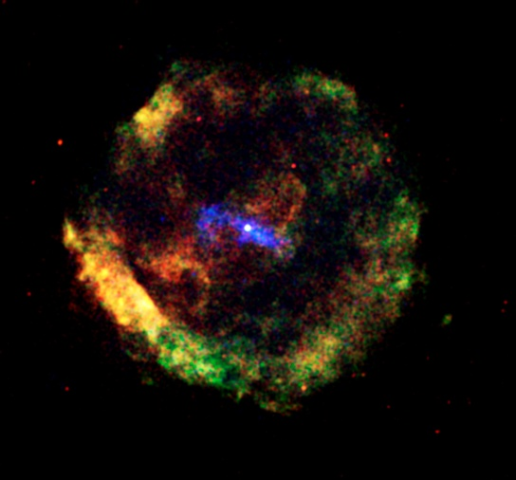
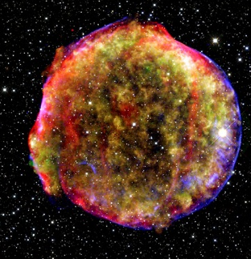
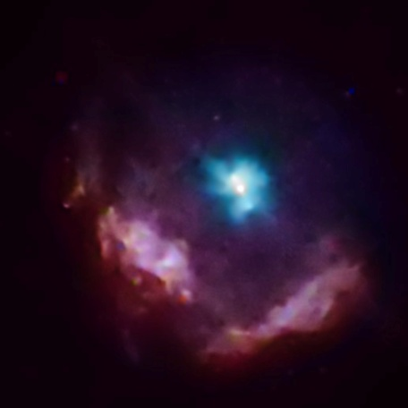
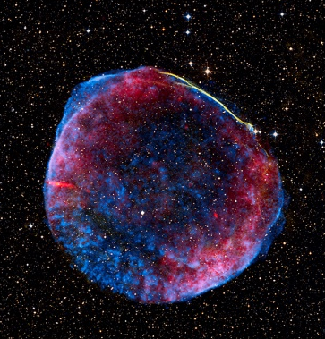
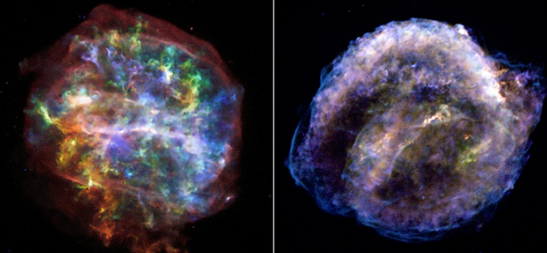
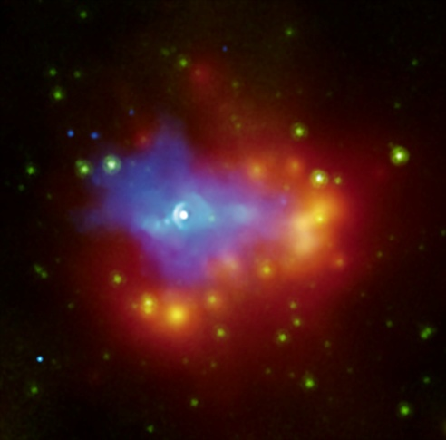
Supernova Remnants

Slide 4
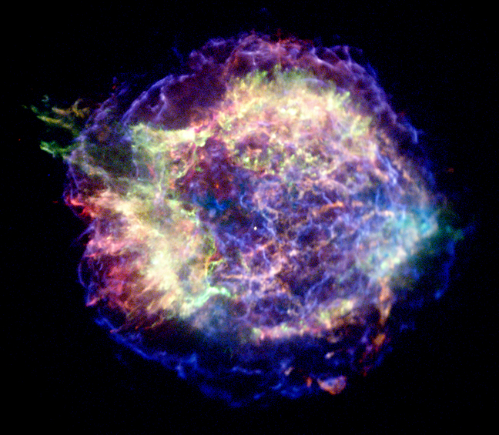

Shock Physics
Forward shock
Density
Reverse shock
Radius
Ejecta
ISM
Reverse shock
Contact discontinuity
Forward
shock

Slide 5
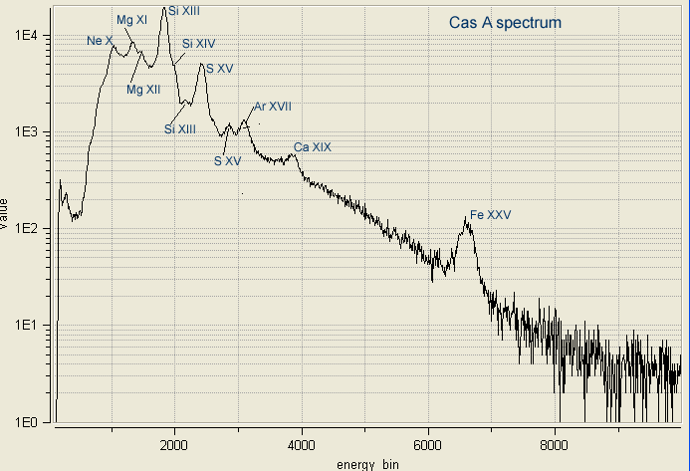
Thermal X-ray emission
n₀
E
v
R
Thermal X-ray spectrum → temperature (10⁷K) and density
Radius → age

Slide 6
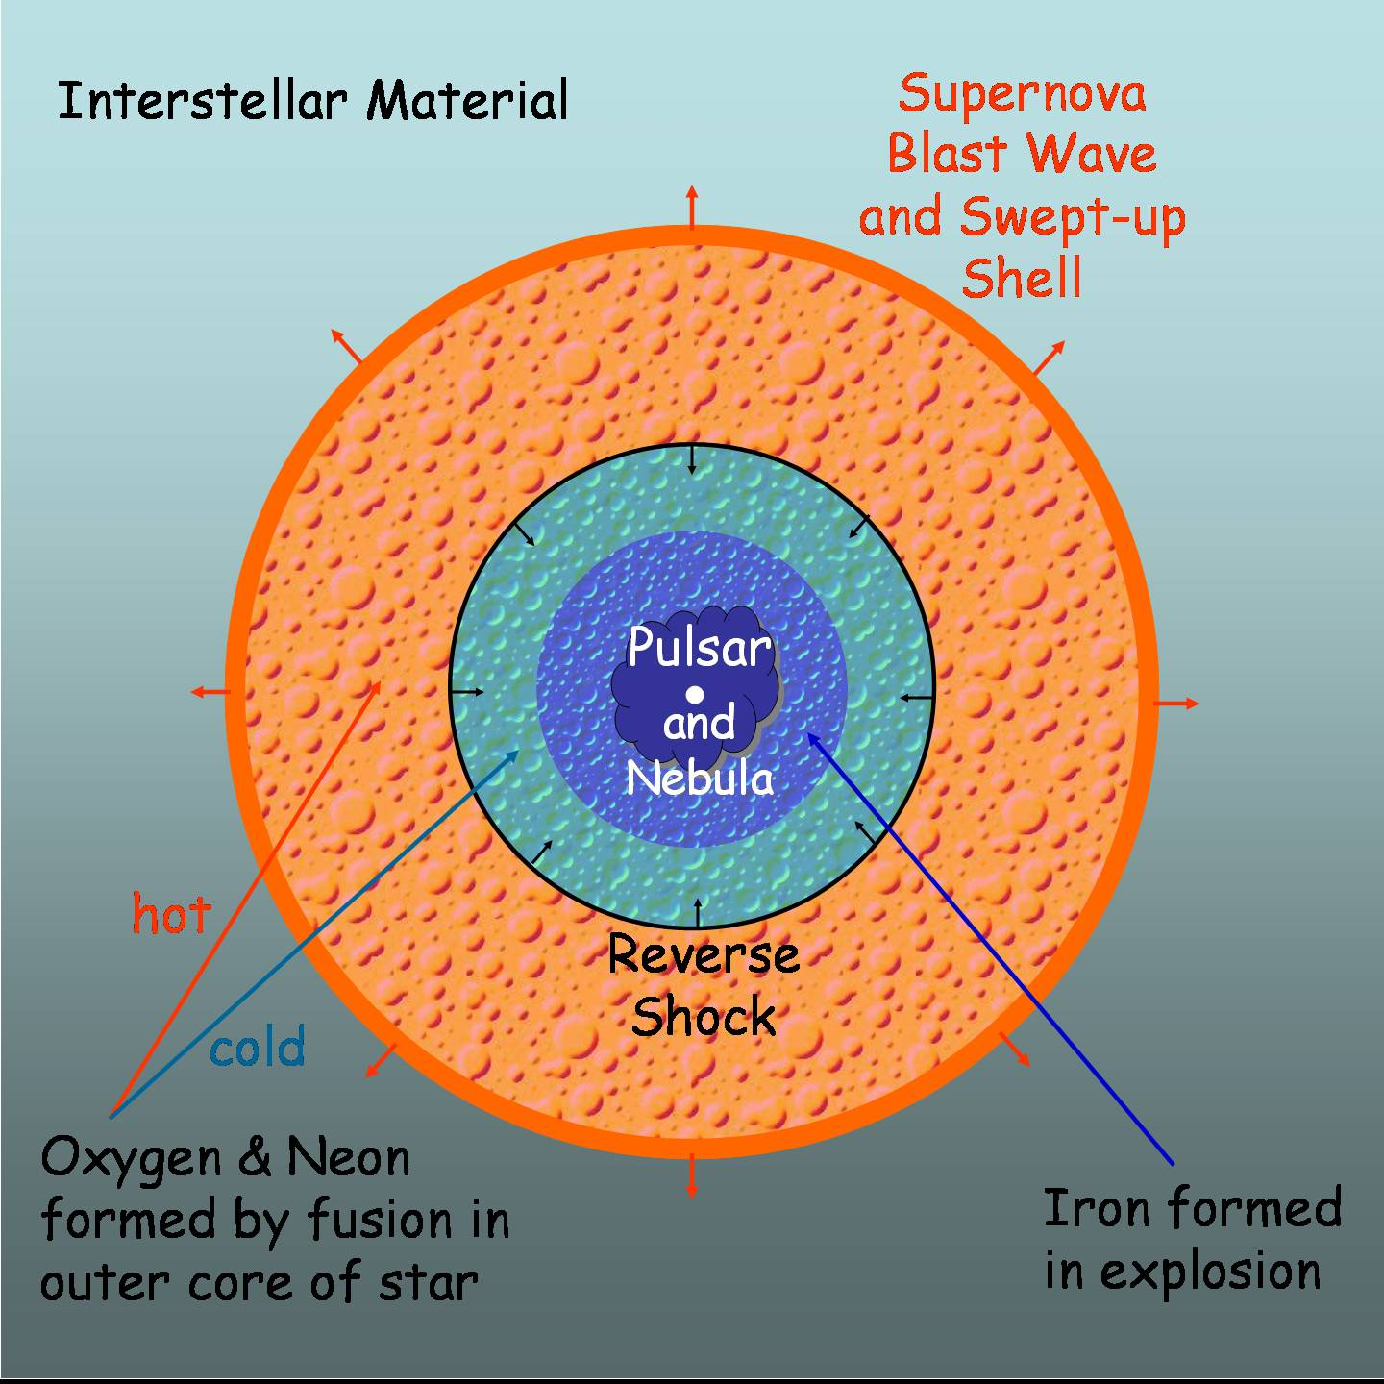
Non-thermal SNRs
Cosmic ray acceleration in strong shocks
B-field + relativistic particles = synchrotron
274 known Galactic SNRs, < 10 synchrotron-dominated
  e.g. SN1006, Vela Jr, G347.3−0.5
Non-thermal features in historical SNRs
  e.g. Cas A, Tycho

Slide 7
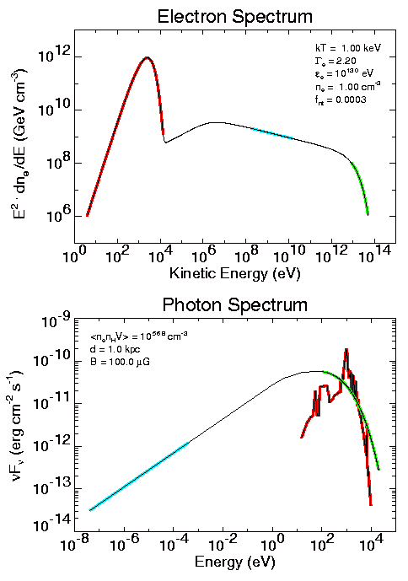
Non-thermal Emission
nonthermal
Allen 2000
thermal
Allen 2000

Slide 8
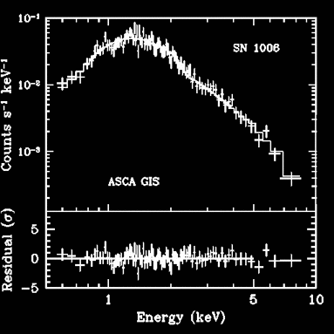
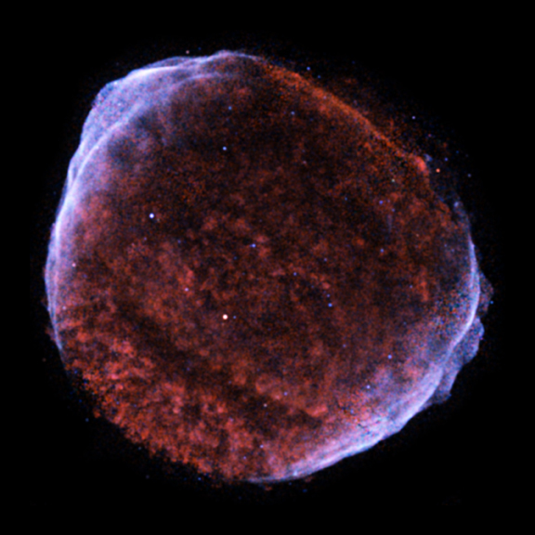
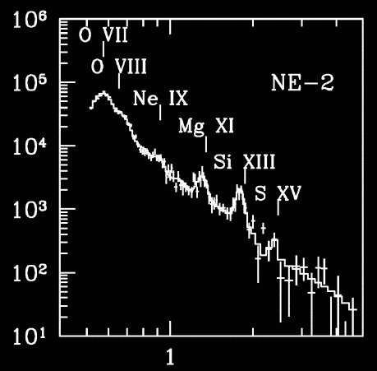
SN 1006
Counts/keV
Cassam-Chenai et al. 2007
Energy (keV)

Slide 9
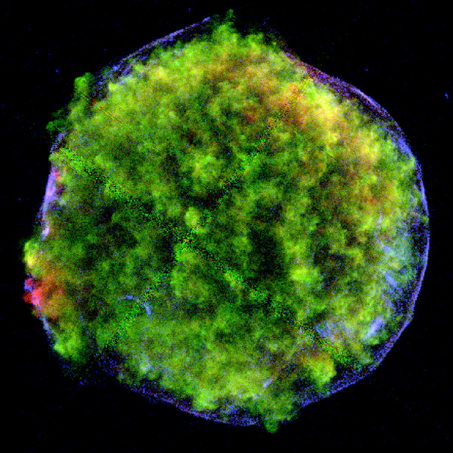
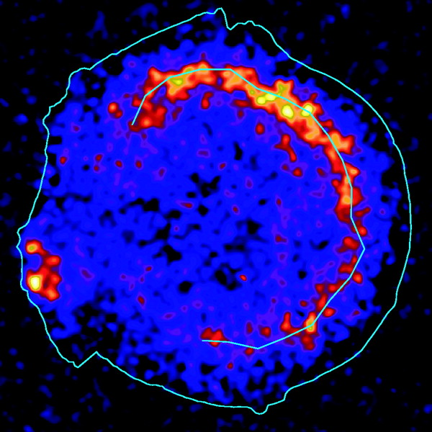
Tycho
Warren et al. 2005
Reverse Shock
(ejecta – Fe,K)
Forward Shock
(nonthermal electrons)

Slide 10
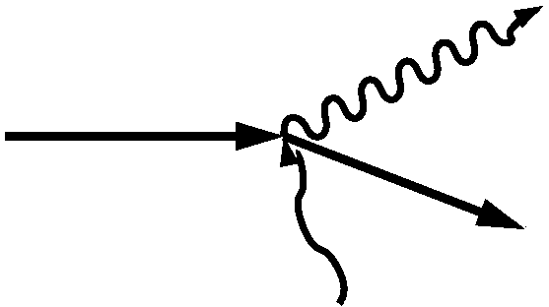
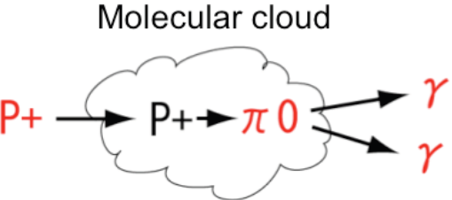
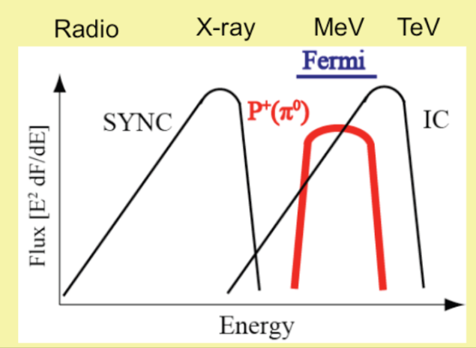
Gamma-ray Production
Leptonic: Inverse-Compton scattering of electrons by CMB, far IR, or star light
Hadronic: Inelastic scattering of protons by nucleons → Neutral Pion decay
π⁰
See talks by Thomas Tam and Bo Zhang

Slide 11
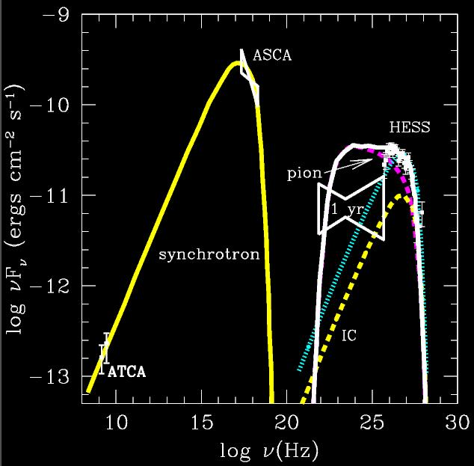
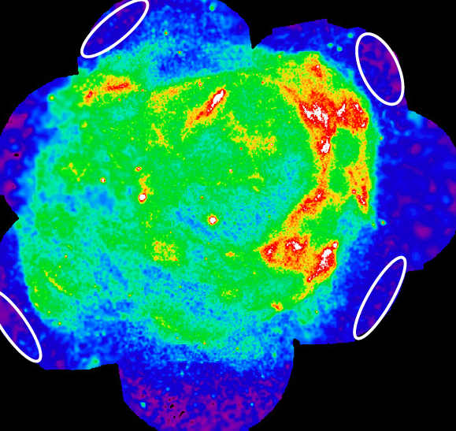
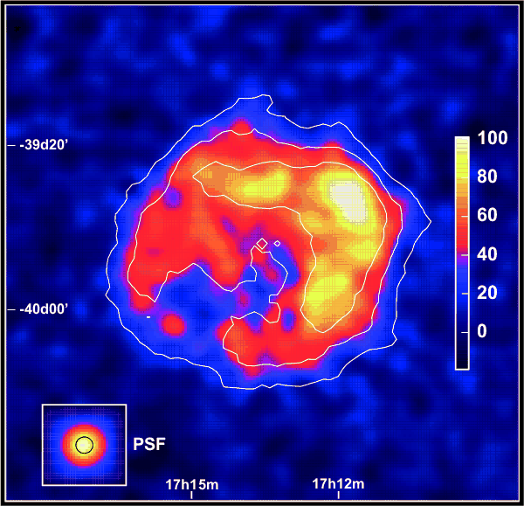
G347.3-0.5 (RX J1713.7-3946)
HESS
XMM
Acero et al. 2009
Aharonian et al. 2006
Similar morphology in X-ray and TeV suggests I-C emission
but spectrum seems to suggest π⁰ -decay

Slide 12
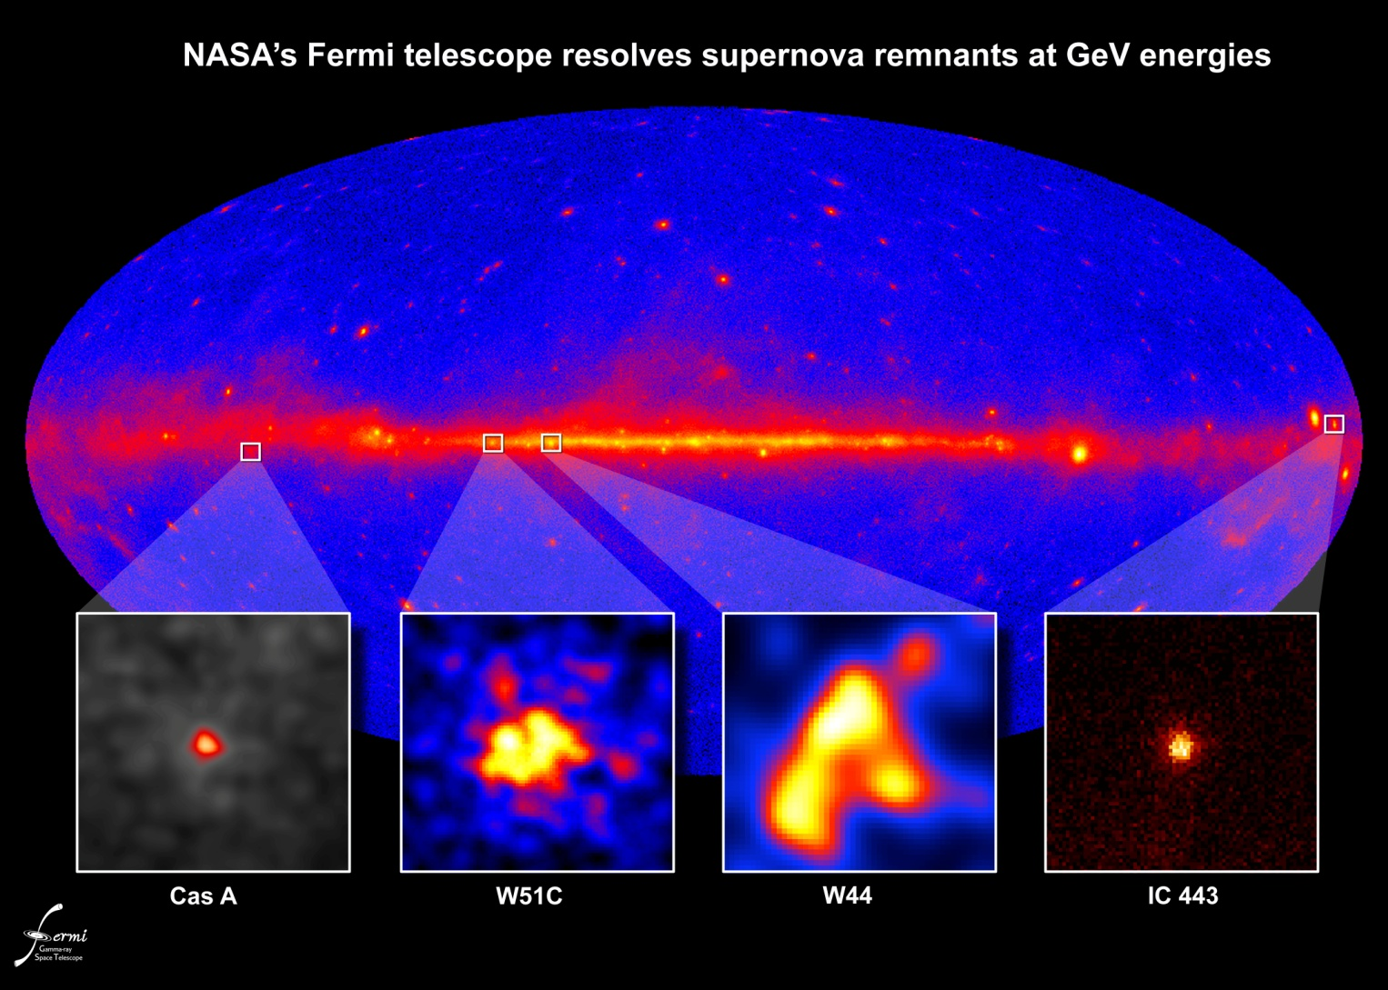
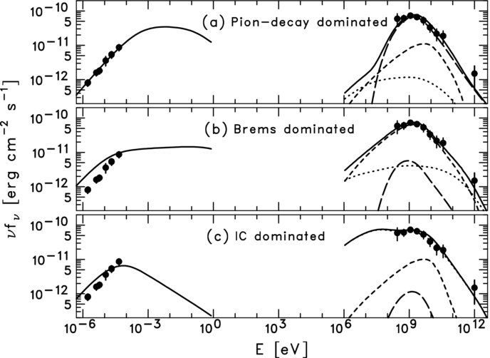
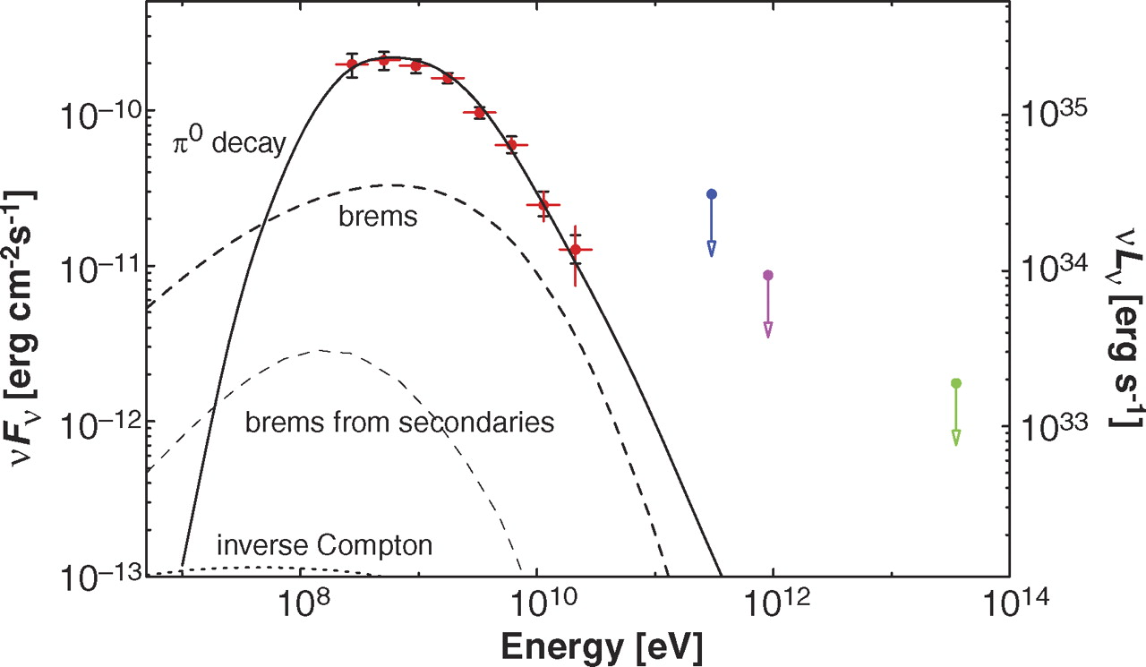
Fermi Detection
W51C
W44
Abdo et al. 2010
Abdo et al. 2009

Slide 13
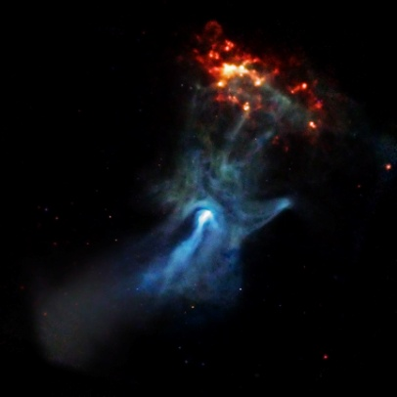
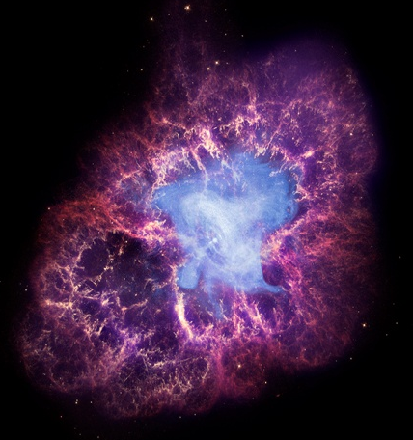
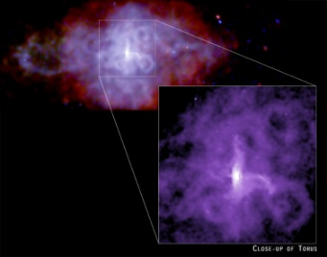

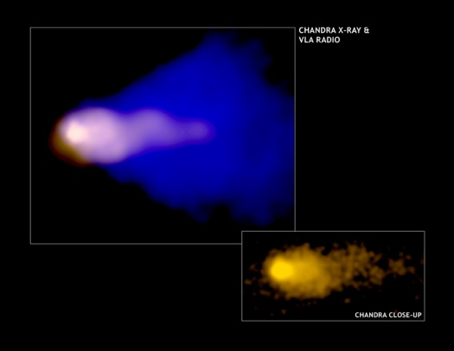
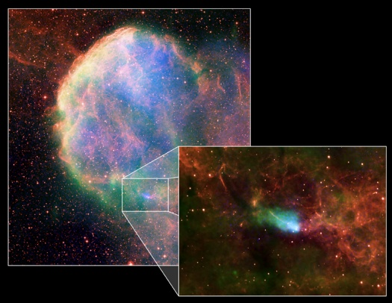
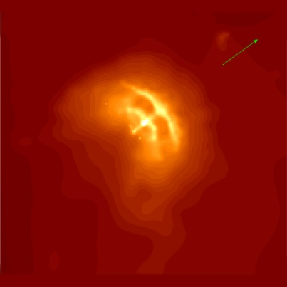
Pulsar Wind Nebulae

Slide 14
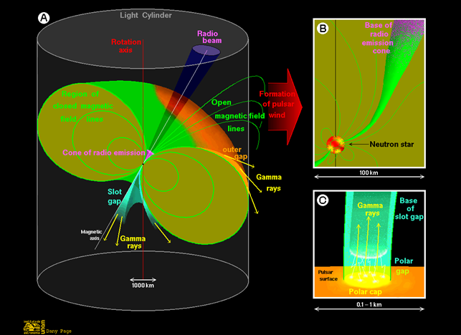
Pulsar Wind
Where does the pulsar rotational energy go?
E>10³⁵erg/s
< 10% in radiation (mostly Gamma-rays)
> 90% in pulsar winds
http://www.astroscu.unam.mx/neutrones/NS-Picture/MagSphe/MagSphe.html

Slide 15
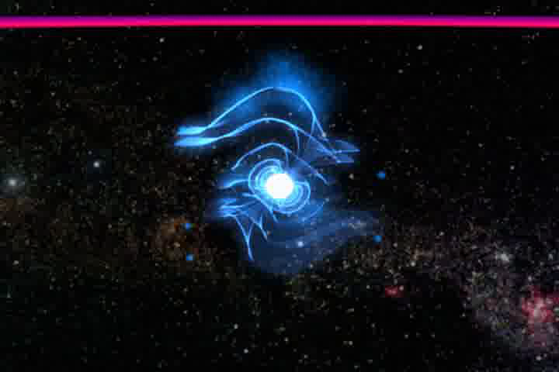
Pulsar Wind

Slide 16
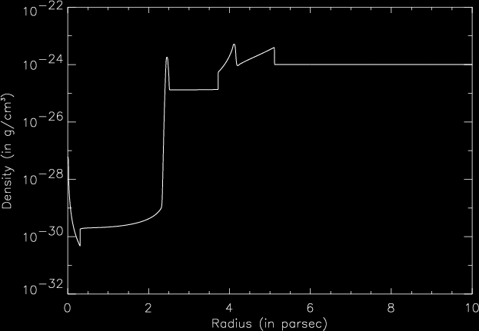
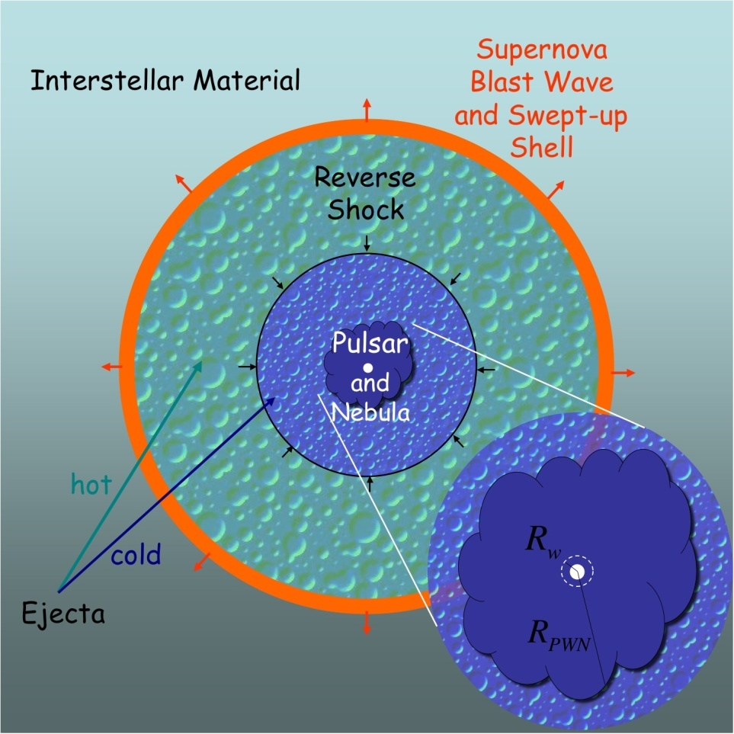
PWN within SNR
Pulsar wind
Ejecta
c
c/3
Termination
shock
PWN Shock
Reverse Shock
Forward Shock
Pulsar
Termination
Shock
Pulsar Wind
Unshocked Ejecta
Shocked Ejecta
Shocked ISM
PWN
ISM
Gaensler & Slane (2006)

Slide 17
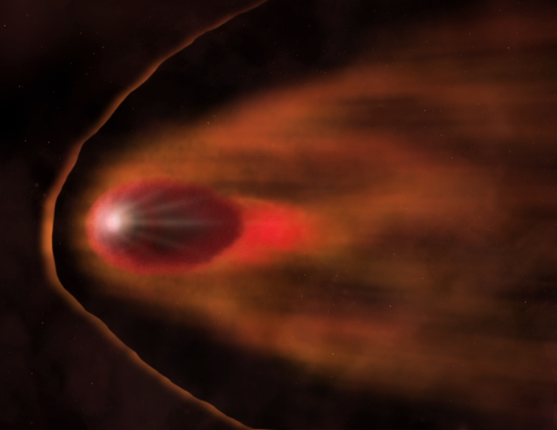
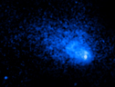
Bow-shocks
IC 443
The Mouse
NASA/CXC/Gaensler et al.
NASA/CXC/SAO/NF/SNRAO/VLA /Gaensler et al.

Slide 18
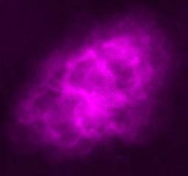
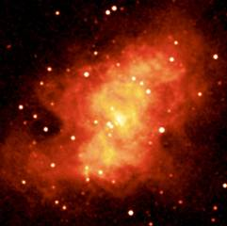
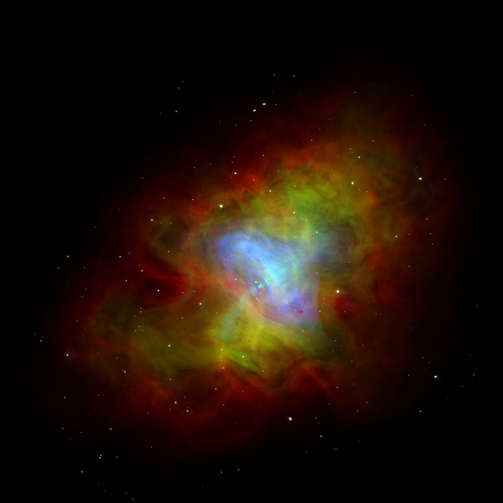
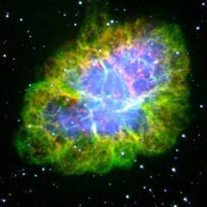
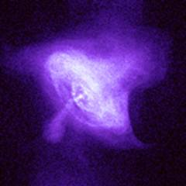
Broadband Emission
NASA/CXC/Palomar/2MASS/NRAO

Slide 19
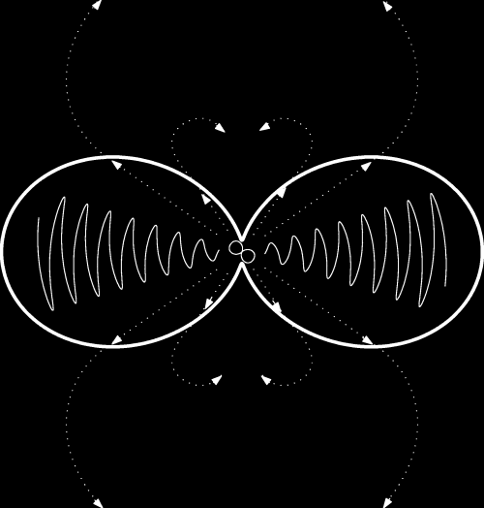
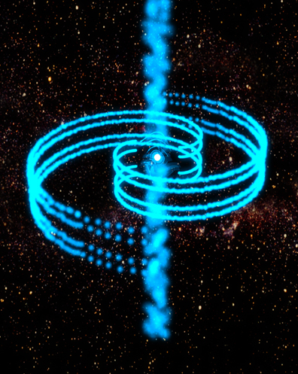
Axisymmetric Structure

Slide 20
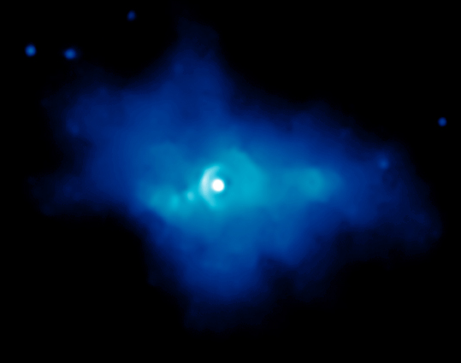
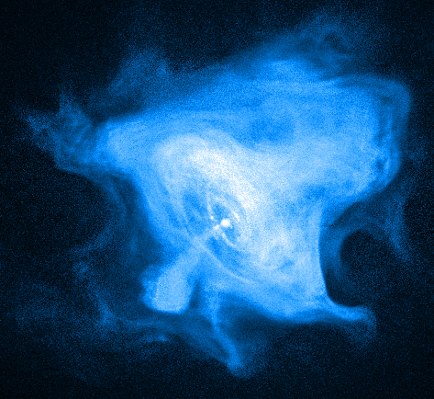
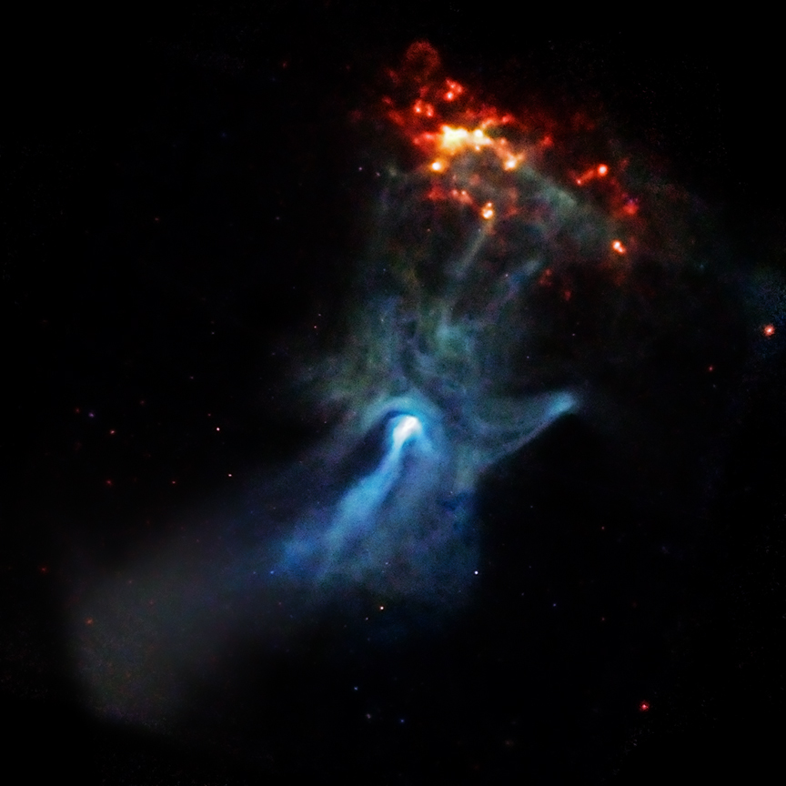
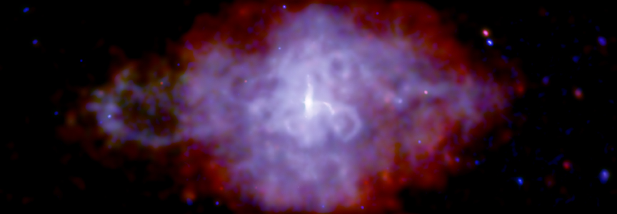
Torus+jet

Slide 21

Time Variability
NASA/ASU/J.Hester et al

Slide 22


Gamma-ray Emission
Crab PWN
synchrotron
Abdo et al. (2010)

Slide 23



TeV PWNe
Vela X
NASA/PSU/G.Pavlov et al.
Aharonian et al. (2006)
LaMassa et al. (2008)

Slide 24



Vela X
de Jager et al. (2008)
Abdo et al. (2010)

Slide 25


G0.9+0.1
LaRosa et al. (2000)
Aharonian et al. (2005)

Slide 26

MSH 15-52 / PSR B1509-58
Aharonian et al. (2005)
NASA/CXC/SAO/P.Slane et al.

Slide 27

Kookaburra Complex
Aharonian et al. (2006)

Slide 28



PSR B1823-13
G18.0-0.7
XMM
Gaensler et al. 2003
Aharonian et al. (2006)

Slide 29
Summary
SNRs and PWNe are important Galactic Gamma-ray source
Broadband emission from radio to TeV
Hadronic and Leptonic scenarios of Gamma-ray production
Fermi can fill up the gap between X-ray and TeV in the SED

