Slide 1
Neutron Star Zoo: radio pulsars, magnetars, RRATs, CCOs, and more
Stephen C.-Y. Ng
McGill University
Special thanks to Vicky Kaspi for some materials in this talk

Slide 2
Overview
Since the first pulsar discovered 40 yrs ago, they are all thought to be:
born spinning fast in SNRs
with magnetic fields ∼10¹² G
emitting radio pulses

Slide 3
The Zoo of Isolated NS
RPP (radio pulsar)
INS (nearby old pulsar)
AXP/SGR (Magnetar)
CCO (Anti-magnetar?)
RRAT (Part-time pulsar)
MSP (Recycled pulsar)
NS
Zoo
from Cupcake Cutiees

Slide 4
Observational Properties
Observable
Characteristic age
Spin-down luminosity
Surface dipole field
Notes:
With P and Pdot, can infer other quantities

Slide 5
P-P Diagram
Notes:
Will see this again and again throughout this talk

Slide 6
Radio Pulsars
Powered by rotational energy, i.e. spin-down
Radio to Gamma-ray emission
Power PWNe
∼1500 known
Could be radio-quiet,
e.g. Geminga
See Lupin Chun-Che Lin ‘s talk
NASA/CXC/SAO/F.Seward et al

Slide 7
Rotation-Powered Pulsars
\
RPPs

Slide 8
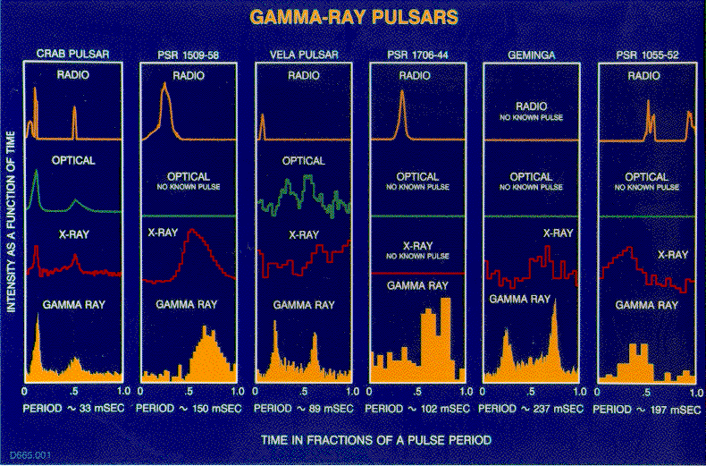
Broadband Emission
Notes:
Now we know that they emit not only radio, but up to gamma-rays (no TeV)

Slide 9
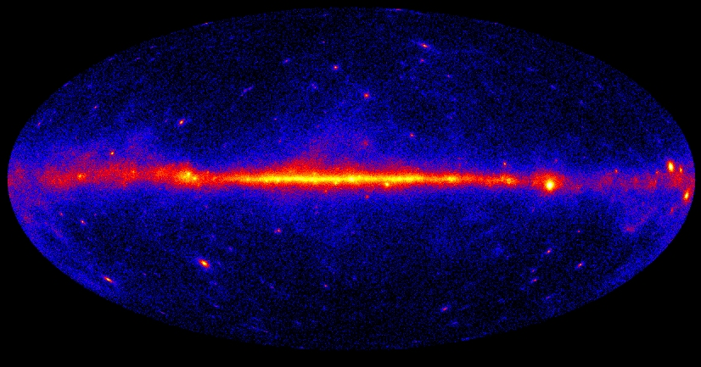
Fermi Pulsars
31+ Gamma-ray and radio pulsars (including 8+ MSPs)
16 + Gamma-ray only pulsars
Pulses at 1/10th real rate
EGRET pulsars
Abdo et al./ Fermi LAT Team
young pulsars discovered using radio ephemeris
See talks by Jumpei Takata, K.S. Cheng and Yu Wang
pulsars discovered in blind search
millisecond pulsars discovered using radio ephemeris

Slide 10
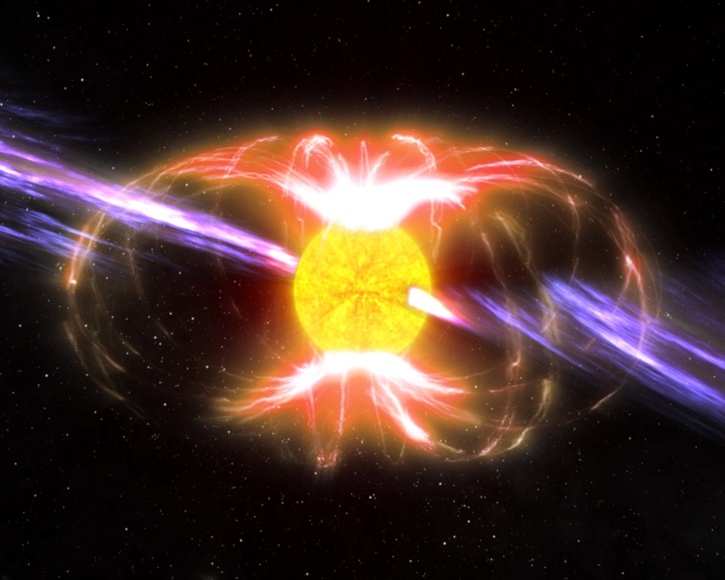
Magnetars: AXPs and SGRs
Anomalous X-ray Pulsar (AXP)
Soft-Gamma Repeater (SGR)
L_{x} >> E
P=2-12s, large P => B∼10¹⁴G
13 known, only 2 in radio
Young, volatile
Spectacular outbursts
see Yunwei Yu’s talk
Notes:
Names are historical
Not to be confused with GRB, which are extra-galactic.

Slide 11
Magnetars
Magnetars
Notes:
Not surprisingly occupy highest B region

Slide 12
Magnetars
0-10s
0-10Myr
>10Myr
Massive
Star
Newborn
Neutron
Star
Magnetar
RPP

Slide 13
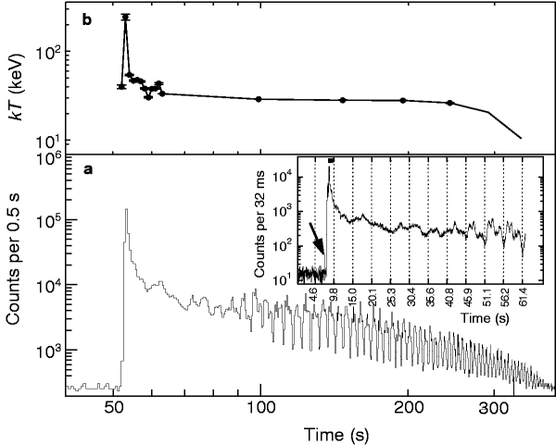
Giant Flare of SGR 1806-20
Dec 27, 2004
100x more luminous than any Galactic transients ever seen
10⁸ L_{Edd}
Hurley et al. (2005)

Slide 15
Notes:
Star quake

Slide 16
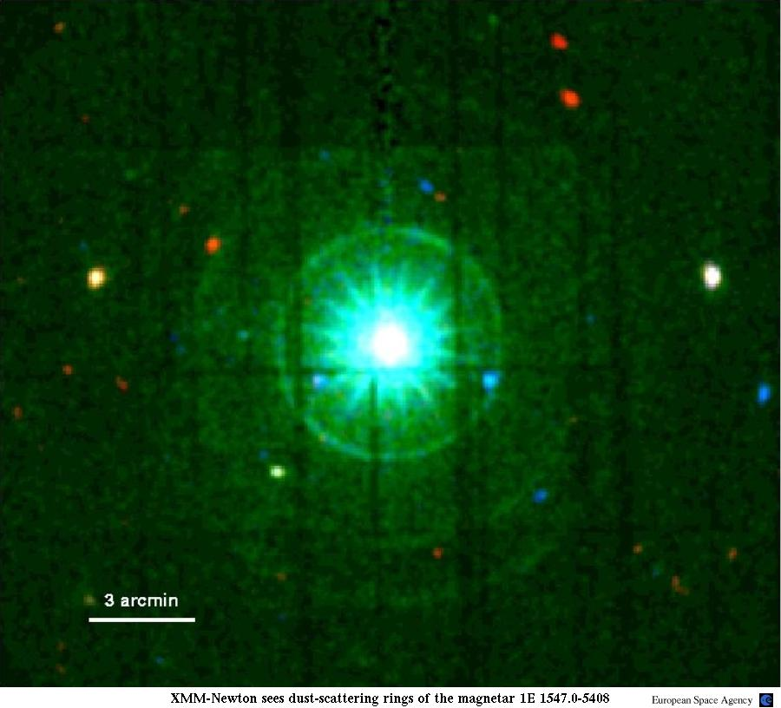
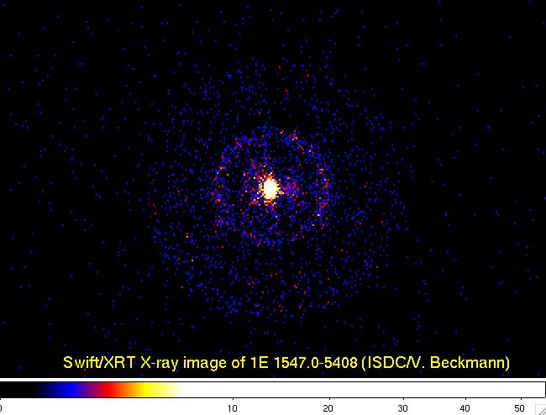
1E 1547.0-5408
2009 Jan Outburst
Dust scattering rings, i.e. light echoes
=> distance
XMM-Newton
Swift
ESA/Tiengo et al.

Slide 17
High-B Rotation-Powered PSRs
High-B RRPs
Notes:
Look careful enough, there are radio pulsars in this region, ~1e13, although not 1e14

Slide 18
High-B RRPs
Name | P (s) | Pdot | B (G) | D (kpc)
J1119-6127 | 0.4 | 4.1e-12 | 4.1e13 | 8.4
J1718-3718 | 3.4 | 1.6e-12 | 7.4e13 | 4.9
J1734-3333 | 1.2 | 2.3e-12 | 5.2e13 | 7.4
J1814-1744 | 4.0 | 7.4e-13 | 5.5e13 | 9.8
J1819-1458 | 4.3 | 5.7e-13 | 5.0e13 | 3.6
J1846-0258 | 0.3 | 7.1e-12 | 4.8e13 | 6
J1847-0130 | 6.7 | 1.3e-12 | 9.3e13 | 8.4

Slide 19
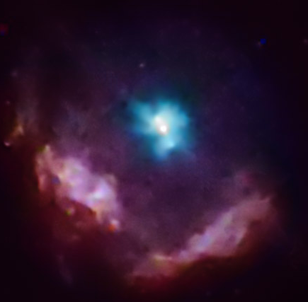
PSR J1846-0258
0.3 s X-ray pulsar in SNR Kes 75
B = 5x10¹³G
Youngest pulsar: 884 yr
No radio emission
NASA/CXC/GSFC/F.P.Gavriil et al.
Notes:
Most spectacular object

Slide 20
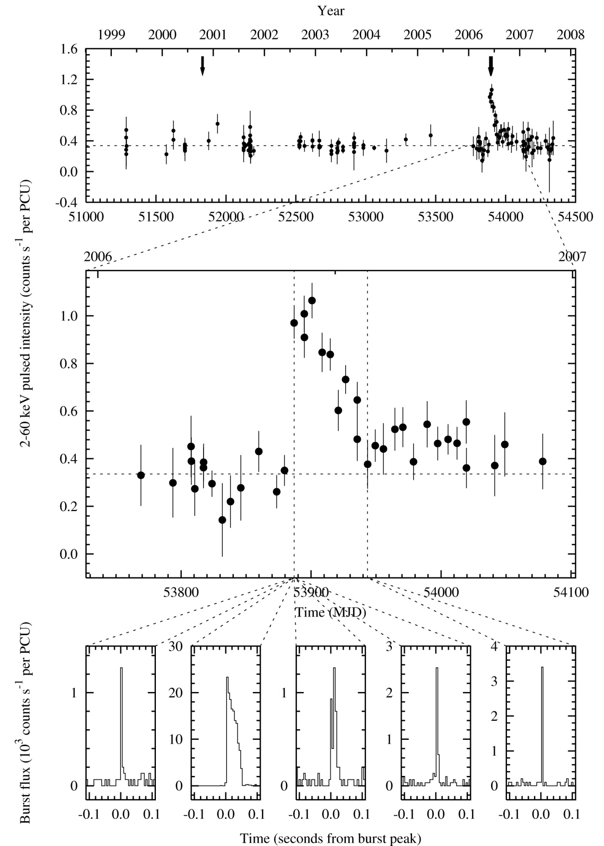
Magnetar-like Outbursts in a Rotation-Powered Pulsar
2000
2006
Gavriil et al. (2008)

Slide 21
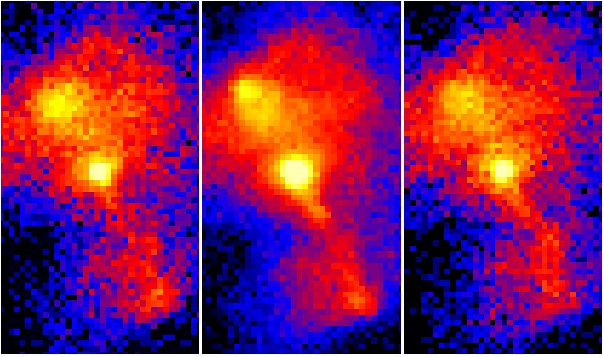
Chandra Observations of Kes 75
2000
2006
2009
Livingstone, SN, Kaspi, in prep.

Slide 22
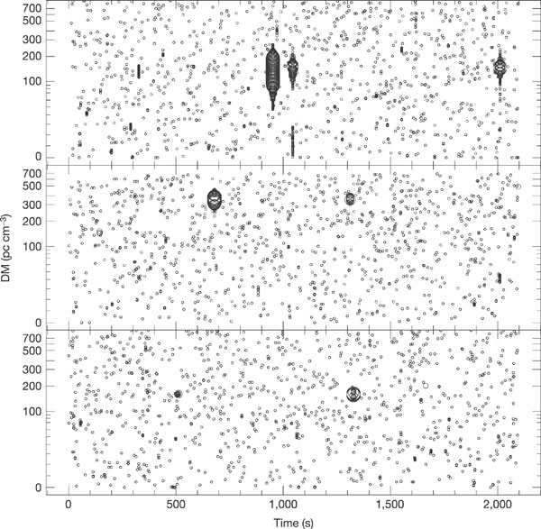
Rotating Radio Transients (RRATs)
Sporadic radio pulse emitters
12 known
Long periods
Bright in radio
Giant pulses?
Intermittent or nulling pulsars?
Nearly dead pulsars? Asteroid belts?
T
2-30ms
4m-3h
Rea et al. 2009
McLaughlin et al. 2007

Slide 23
Rotating RAdio Transients
RRATs

Slide 24
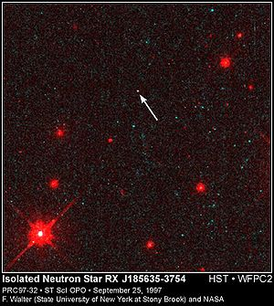
Isolated Neutron Stars
7+1 known (Magnificent Seven + Calvera)
Nearby (most < 1kpc)
Inferred B-fields 1-3x10¹³G
No radio emission
Believed to be old pulsars
Notes:
If u’ve ever watched the movie, will know why
J1856, the ‘leader’ of 7, brightest

Slide 25
Isolated Neutron Stars
INSs
Notes:
High B-field, maybe selection effect, heating

Slide 26
Central Compact Objects
∼7 known
Found near the center of SNRs => young
No radio, IR, optical counterparts
Isolated, no PWN
Thermal X-ray spectrum, hot temp small R
Cas A: Chandra first light
First CCO
NASA/CXC/SAO/D.Patnaude et al.
Notes:
Those we don’t know how to classify

Slide 27
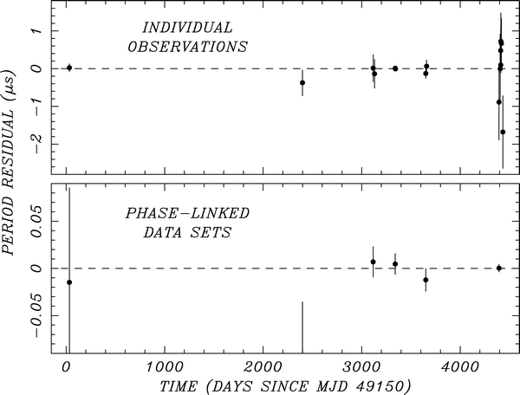
CCOs as “Anti-Magnetars”?
Only 3 CCOs show X-ray pulsations:
CCO in PKS 1209-52: B<3x10¹¹G (Gotthelf & Halpern 2007)
CCO in Puppis A: B<10¹²G (Gotthelf & Halpern 2009)
CCO in Kes 79: B=3x10¹⁰G! (Halpern & Gotthelf 2010)
CCOs as “Anti-magnetars”, born with weak B?
Halpern & Gotthelf (2010)

Slide 28
Central Compact Objects
CCOs
Notes:
1 detection, 2 upper limits

Slide 29
Millisecond Pulsars
P=0.001s – 0.01s
Age > 1Myr
Spun up by accretion
Recycled pulsars
Fermi detection
See talks by David Hui and Yi Jung Yang
Notes:
Won’t talk about them, mention just for completeness

Slide 30
Millisecond Second PSRs
MSPs

Slide 31
Unification?
Log B
14
Magnetars
Isolated Neutron Stars
12
Radio Pulsars RRATs
10
“anti-magnetars”
Millisecond pulsars
8
Log Age
2
4
6
8
10
Kaspi (2010)
Notes:
Just ended by an attempt to unify, born differently?

Slide 32
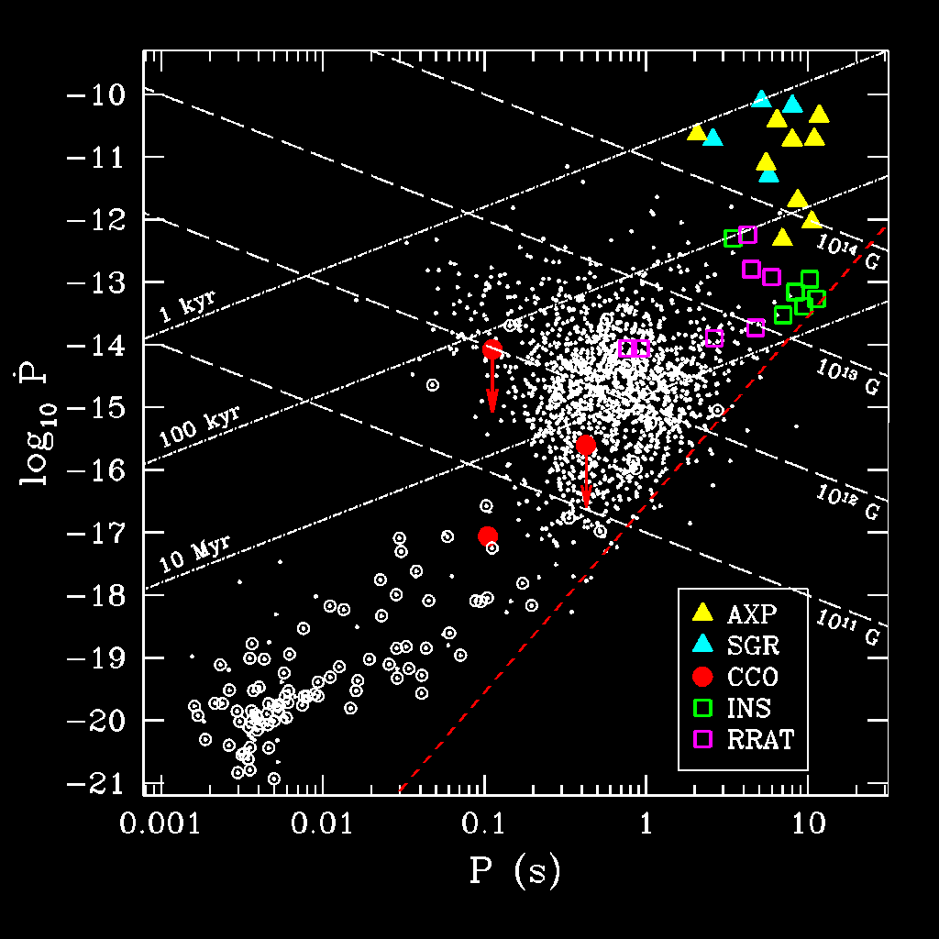
Summary
RPP (radio pulsar)
INS (nearby old pulsar)
AXP/SGR (Magnetar)
CCO (Anti-magnetar?)
RRAT (Part-time pulsar)
MSP (Recycled pulsar)

