Slide 1

GAMMA-RAY BURSTS AND MAGNETARS
Yun-Wei YU
俞云伟
June 22, 2010, Hong Kong

Slide 2
Outline
Background
Implications from the shallow decay afterglows of GRBs
A qualitative discussion on magnetar wind emission
Emission from the termination shock of the wind

Slide 3
1 Background

Slide 4
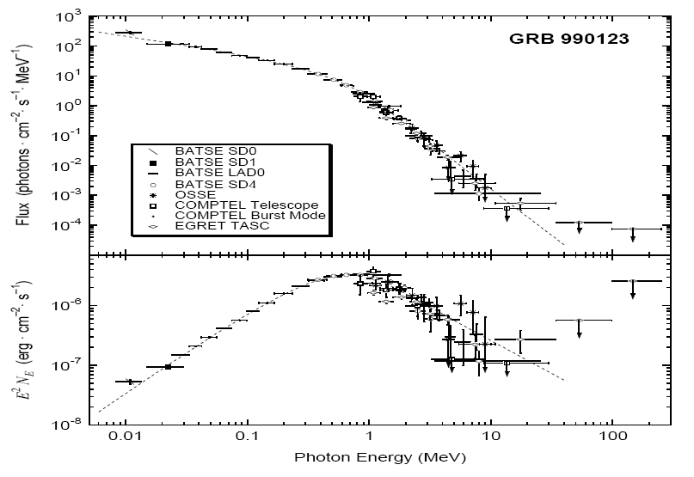
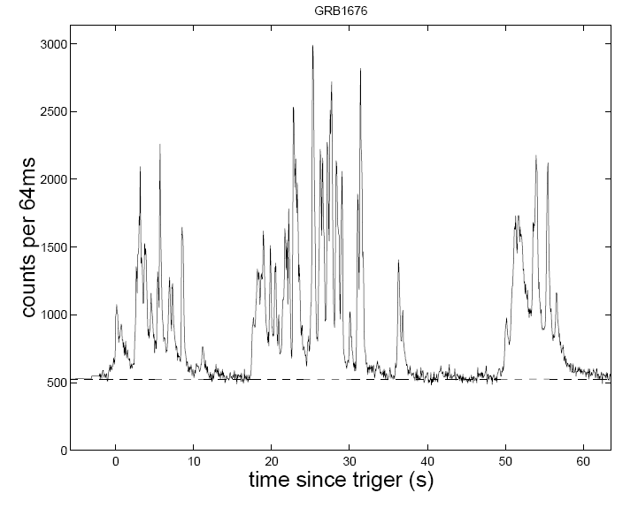
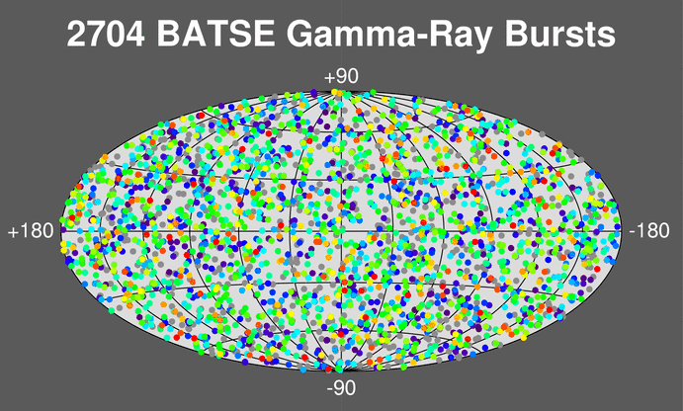


The basic properties of GRBs
Spectrum
Light curve

Slide 5
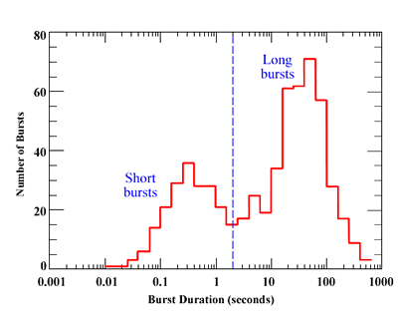
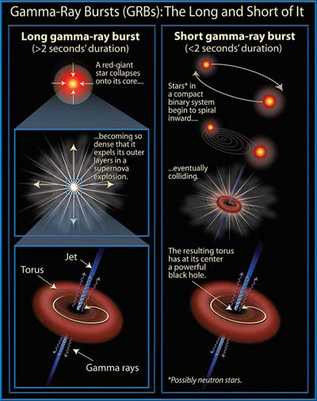
Two possible progenitors
What is the remnant central compact object?
Black Hole
or
Neutron Star?

Slide 6
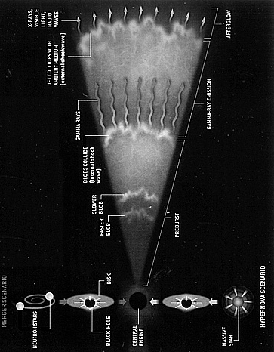
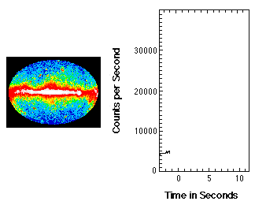
Fireball model
F
Afterglow Emission
t
Prompt Emission

Slide 7
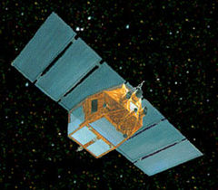
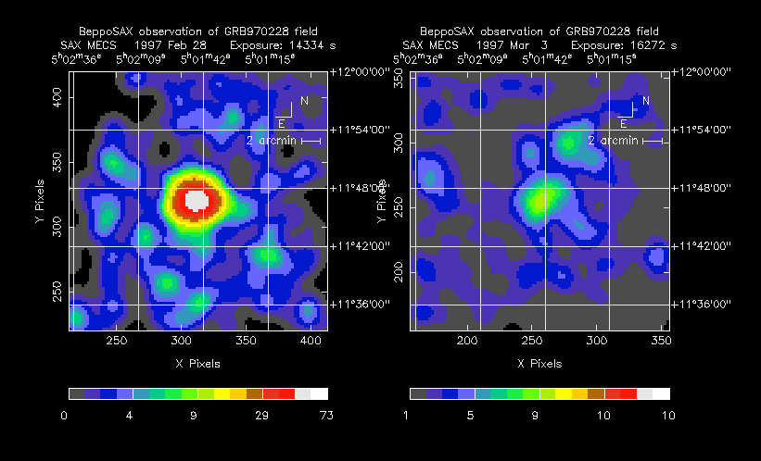
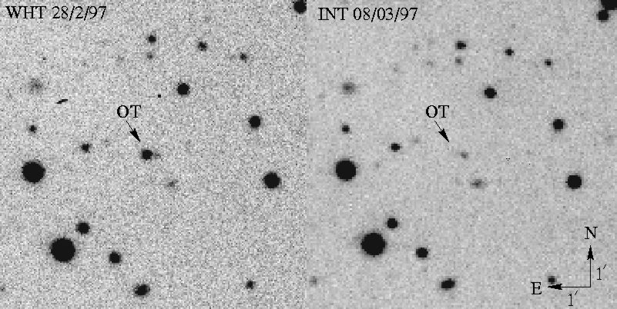
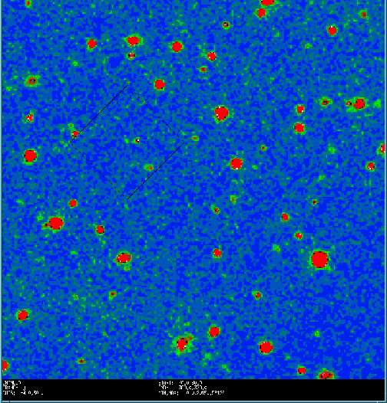
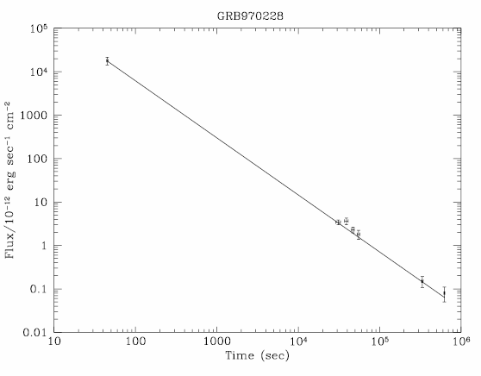
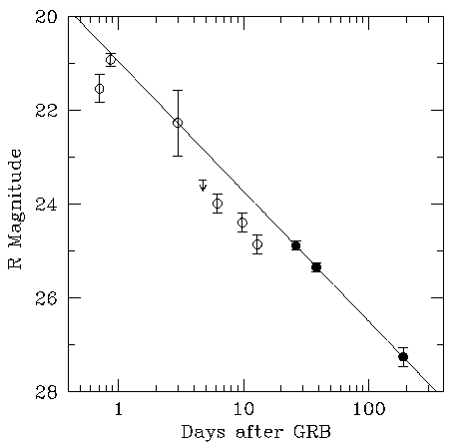
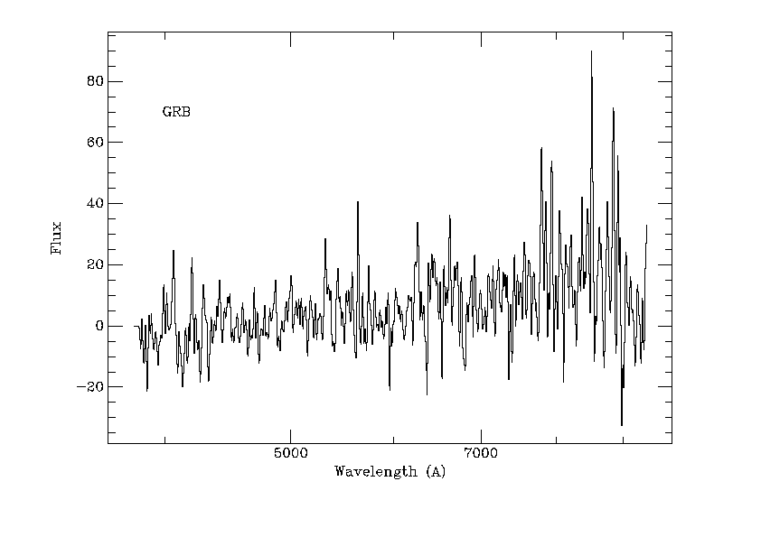
1997: The detection of afterglow emission from GRB970228
BeppoSAX
X－ray
optical

Slide 8

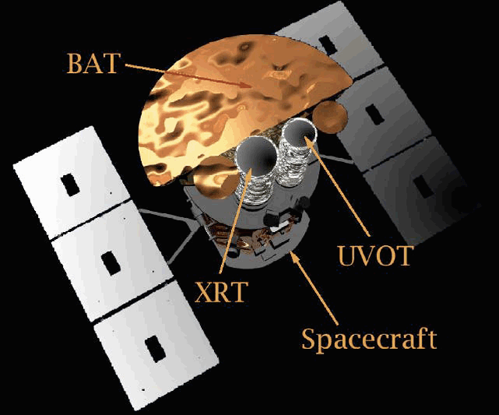
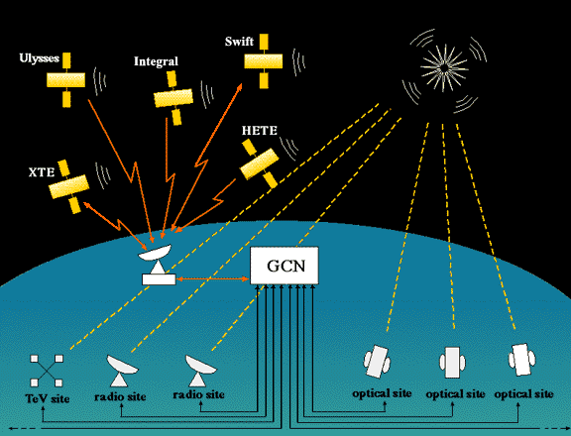
November 20th, 2004, Swift satellite was launched, where three instruments on board including BAT, XRT, and UVOT.

Slide 9
The main achievements of Swift
Uncovered many detailed features of the X-ray afterglow light curves
Multi wavelength observations for the prompt emission
Detected very high-redshift GRBs
Discovered the afterglow emission of short GRBs and thus their host galaxies
……

Slide 10
2, The shallow decay afterglows and millisecond magnetars

Slide 11
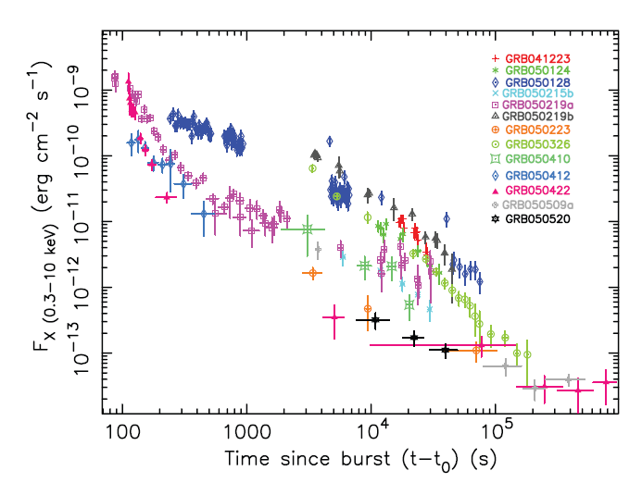
F
t
Two problems:
Why the early light curve is much flatter than the one predicted by the standard model?
How can the sharp flares occurred during the afterglow phase?
F
Standard model
t

Slide 12
A very probable answer:
The GRB central objects have long-lasting activities after the burst phase.
e.g., Yu & Dai (2009)

Slide 13
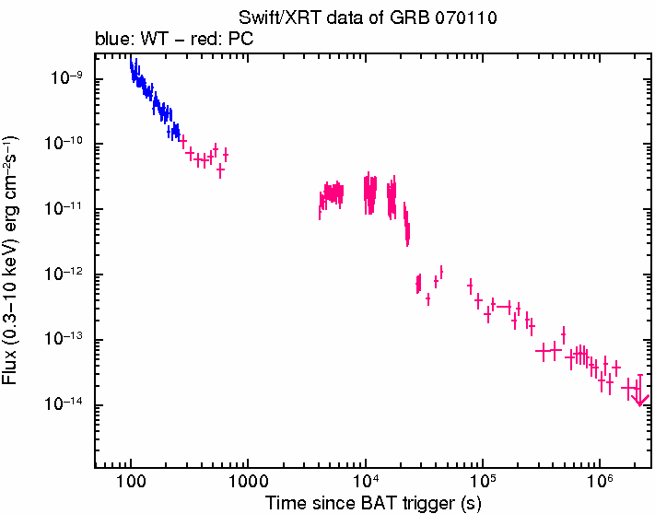

Slide 14
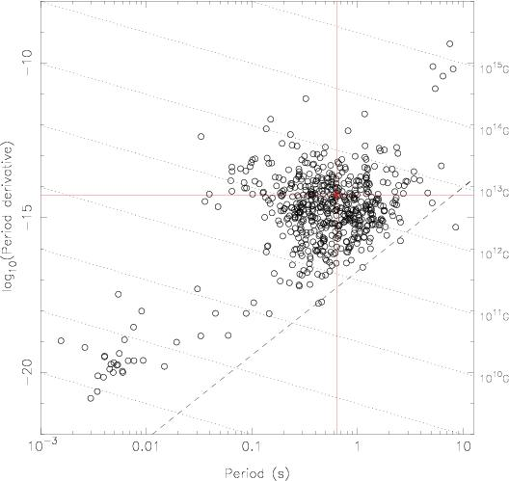
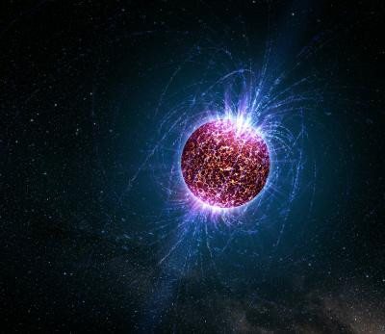
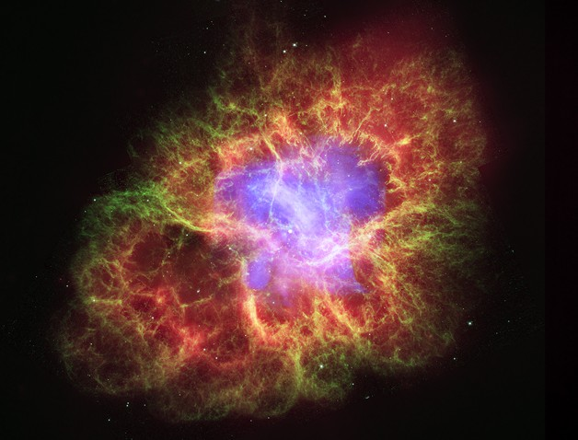
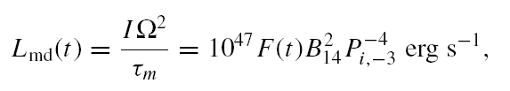
Millisecond magnetars could be plausible candidates
Millisecond magnetars
Several models have been proposed to describe how a millisecond magntar can driven a GRB

Slide 15
A natural consideration: Energy injection
GRB ejecta and shocked medium
Surrounding medium
Magnetar
The spin-down energy of the magnetar could be absorbed by the GRB blast wave —— The shallow-decaying afterglow
Dai & Lu (1998)
GRB external shock

Slide 16
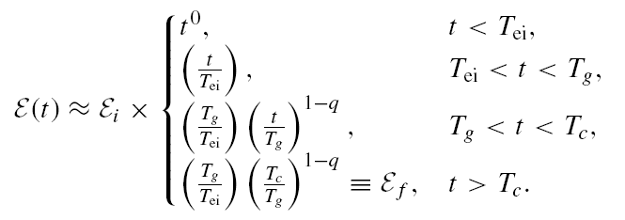
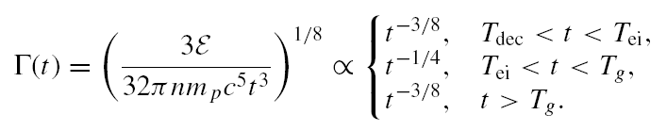
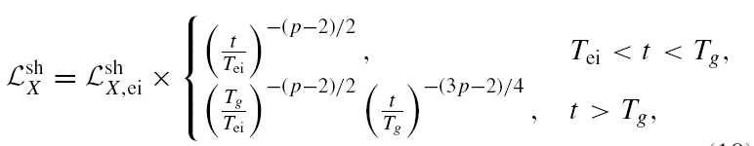
Emission from an energized shock

Slide 17
3, A qualitative discussion on wind emission

Slide 18
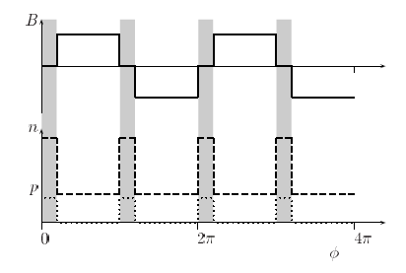
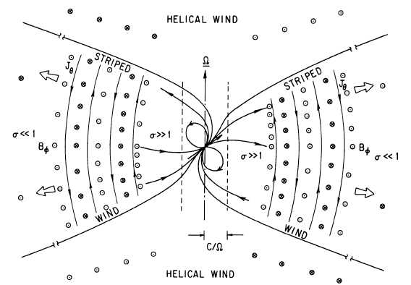
Supernova ejecta
Pulsar wind

Slide 19
Can the wind produce emission directly?
GRB ejecta and shocked medium
Surrounding medium
Magnetar
Two Emitting Regions:
The GRB Shock and The magnetar Wind
GRB external shock

Slide 20
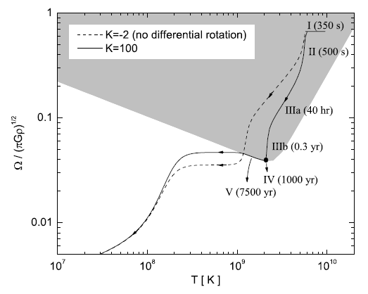
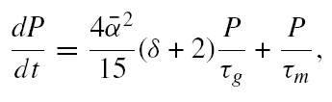
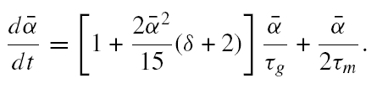

The spin-down of a magnetar
Yu, Cao, & Zheng (2009)

Slide 21

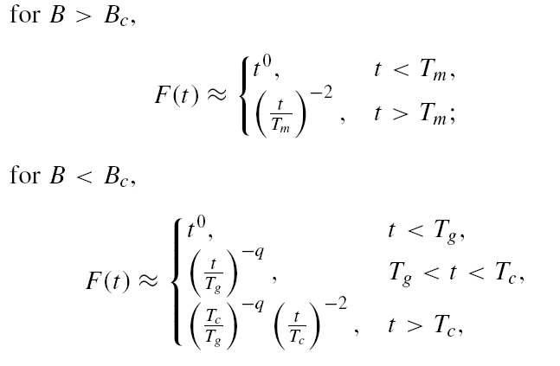
The spin-down of a magnetar
Yu, Cheng, & Cao (2010)

Slide 22
Emission from an energized shock

Slide 23
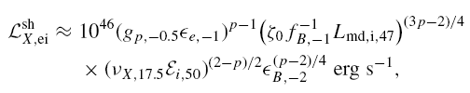
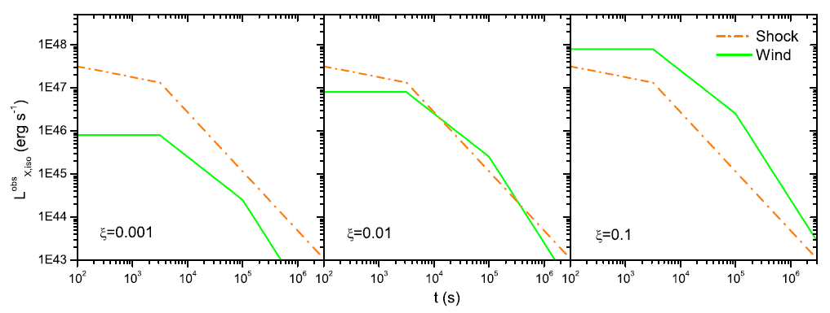

Slide 24
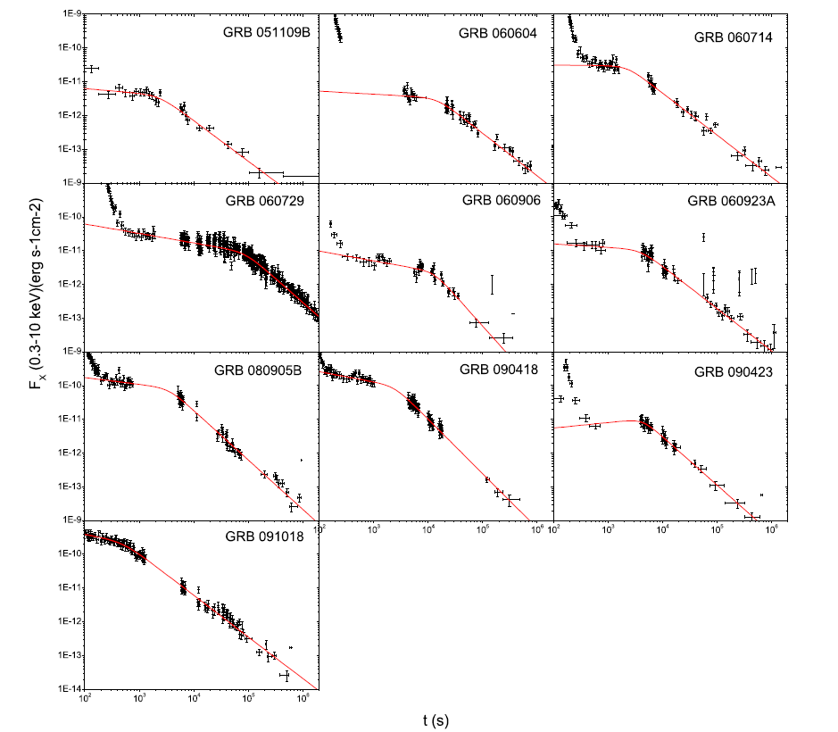
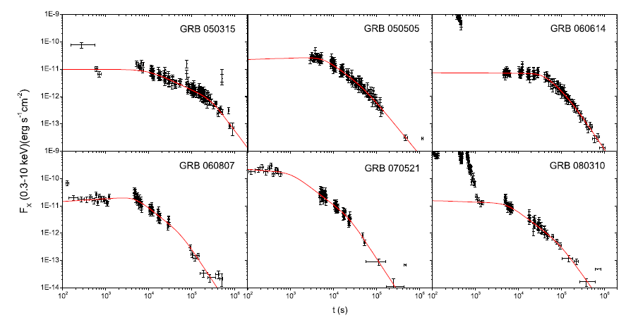
Shock Emission?
Wind Emission?

Slide 25
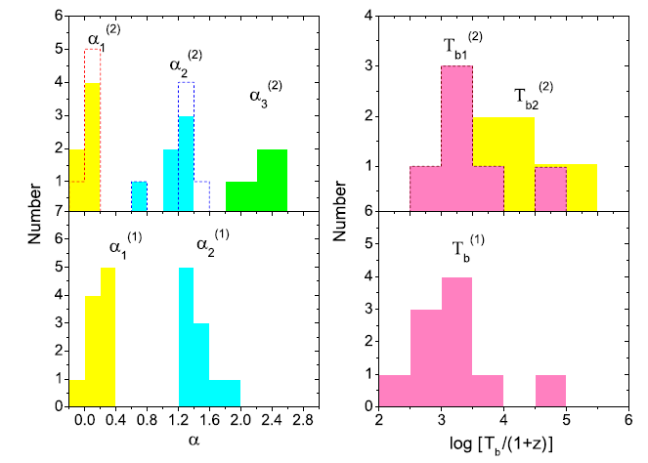

Slide 27

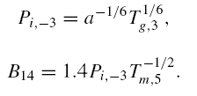
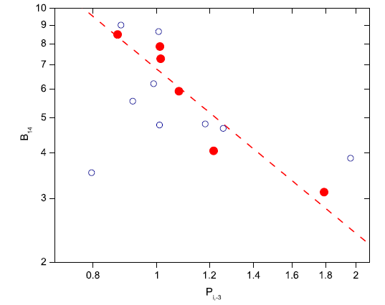

Implications to the properties of magnetars

Slide 28
4, the termination shock of the magnetar wind

Slide 29
Wind termination shock
GRB external shock
Yu & Dai (2007)
4
3
2
1
Unshocked wind
Shocked wind
Shocked medium
Unshocked medium

Slide 30

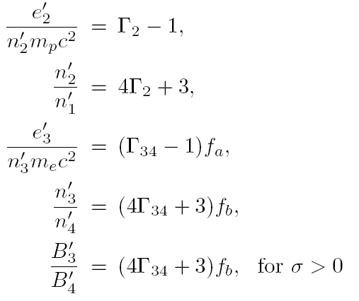
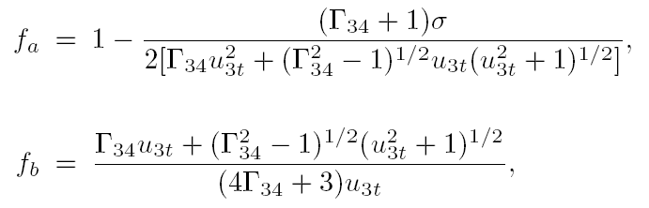

Slide 31
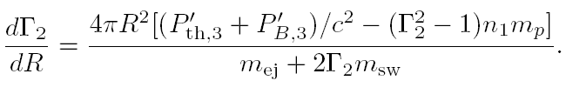
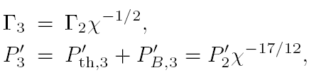

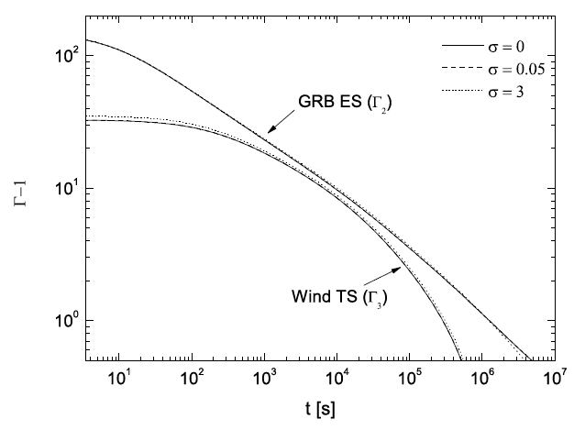
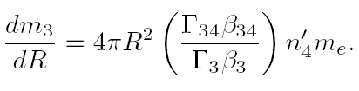
Yu & Dai (2007)
Mao, Yu, Dai et al. (2010)

Slide 32
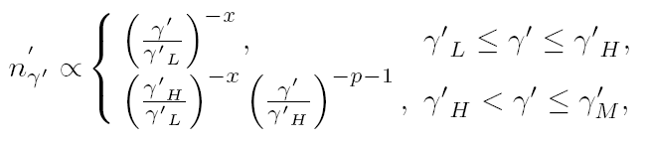
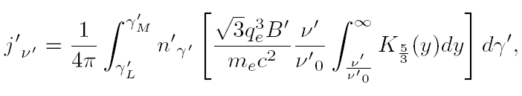
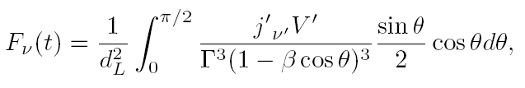
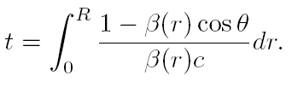

Slide 33
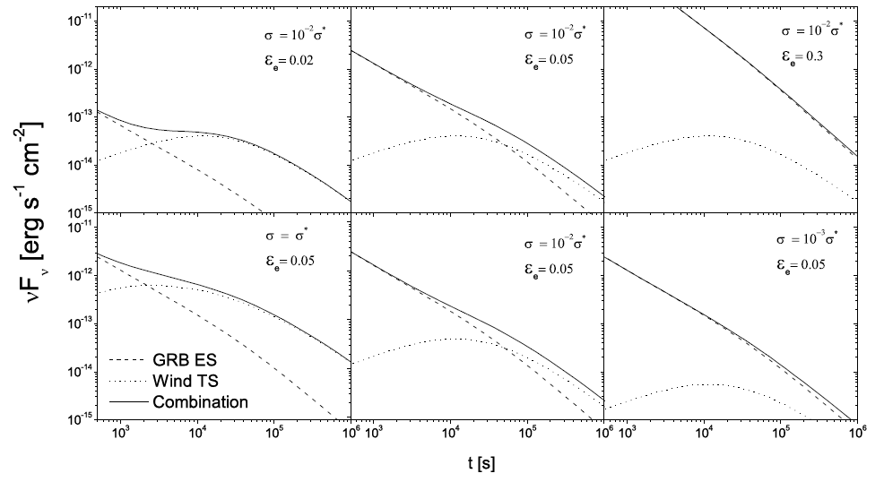

Slide 34
Conclusions
The central objects of SOME gamma-ray bursts could be millisecond magnetars.
Some x-ray afterglow emission could be directly produced by magnetar winds, rather than the external shock.
We may be able to derive the properties of some newly born magnetars from some observational GRB afterglow data.
More careful calculations are needed.

Slide 35
Thank you!

